Slide 1
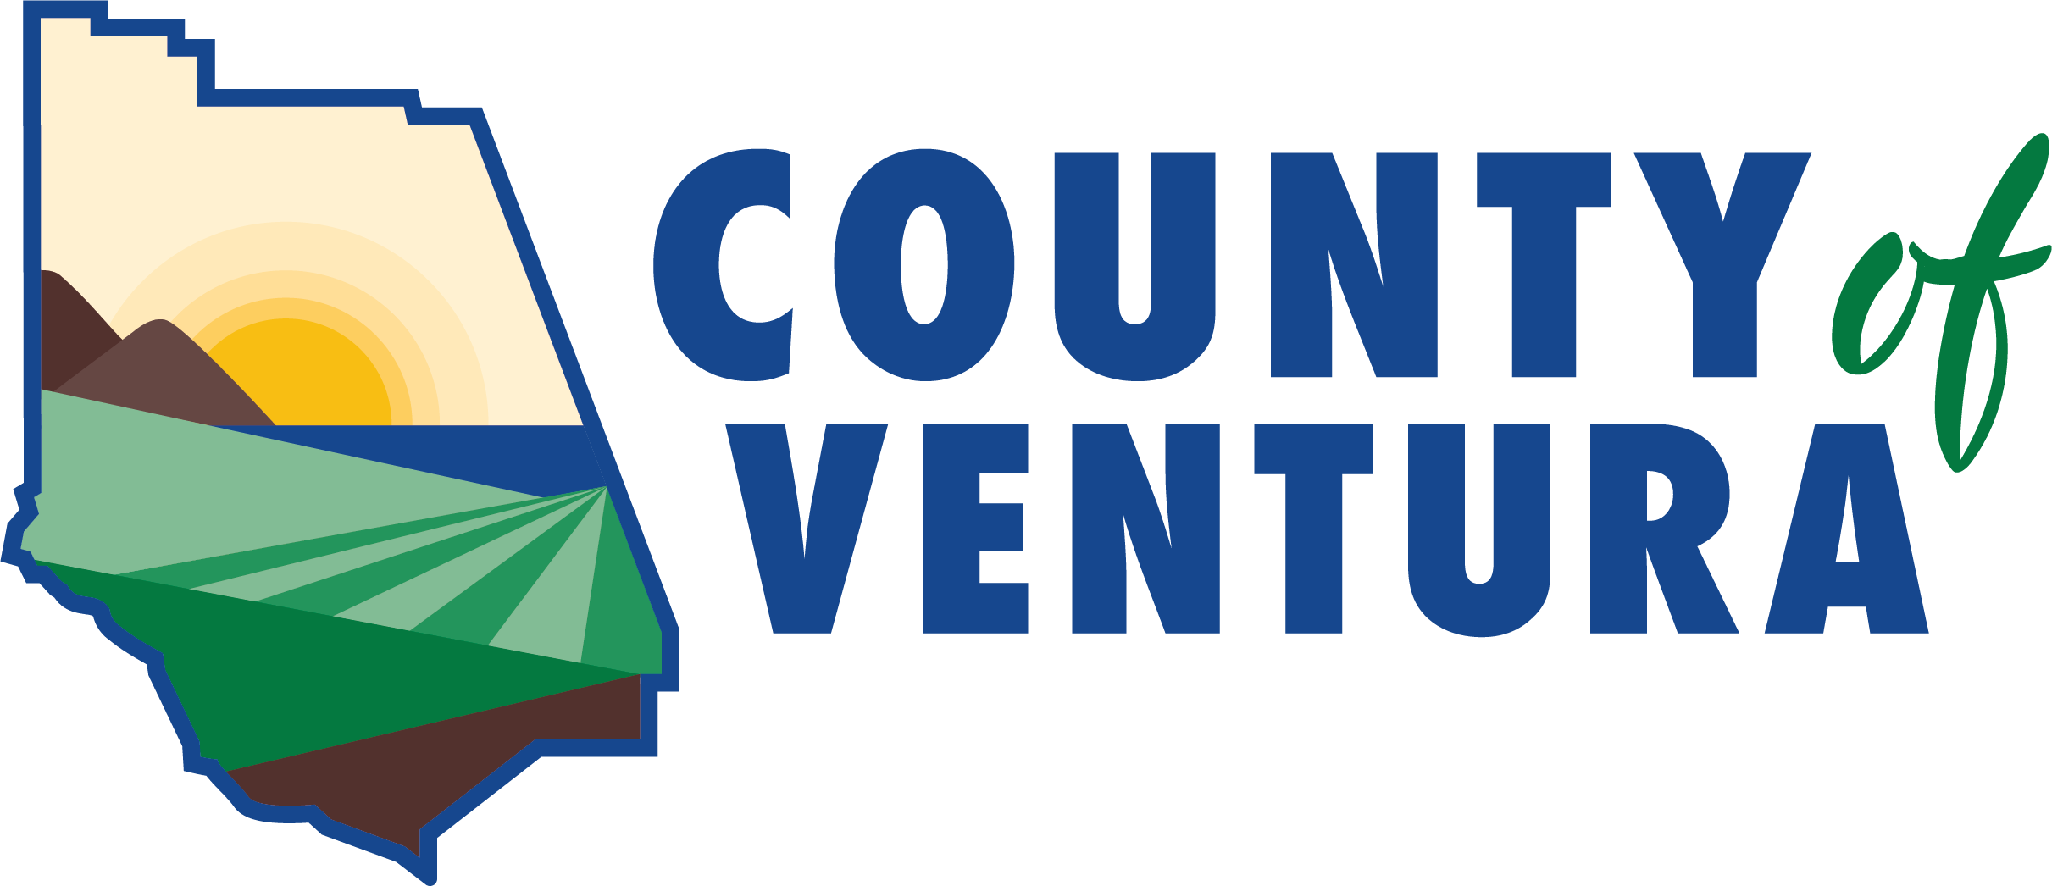
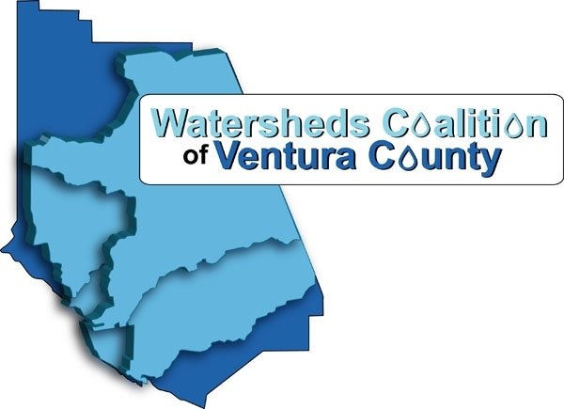
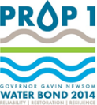
WATERTALKS
Funding for Water-Related Projects
WATERTALKS TOOLKIT
GLAC COMMUNITY
Watersheds Coalition of Ventura County
Integrated Regional Water Management Region
July X, 2019
February 1, 2022
Prepared by: Water Resources & Policy Initiatives,
California State University & PlaceWorks
In collaboration with: California Rural Water Association
Funded by California Department of Water Resources and Prop 1
Notes:
Speakers: Lara

Slide 2
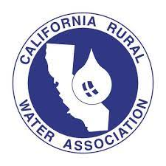
Project Description Webinar Team
WHO IS RUNNING
THIS WEBINAR?
County of Ventura
Lara Shellenbarger
Lynn Rodriguez
PlaceWorks
Isabelle Minn
Dina El Chammas Gass
Spence Koehler
CSUSB
Boykin Witherspoon
Melissa Moreno
Miranda Moore
California Rural Water
Association
Holly Alpert
CSUN
Ben Chou
Notes:
Add emails for version that is posted on web.
You’ll be hearing from today…

Slide 3
ZOOM MEETING CONTROLS (Desktop)
WHAT TECHNICAL ISSUES SHOULD YOU BE AWARE OFF?
Access the chat window
Submit questions or comments via chat
Type Message Here

Slide 4
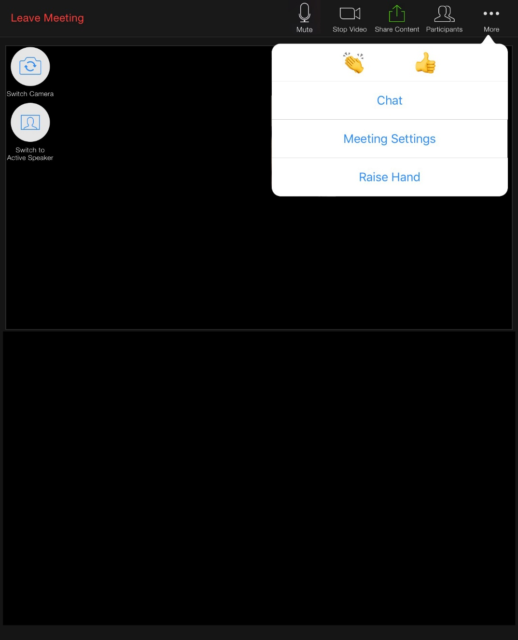
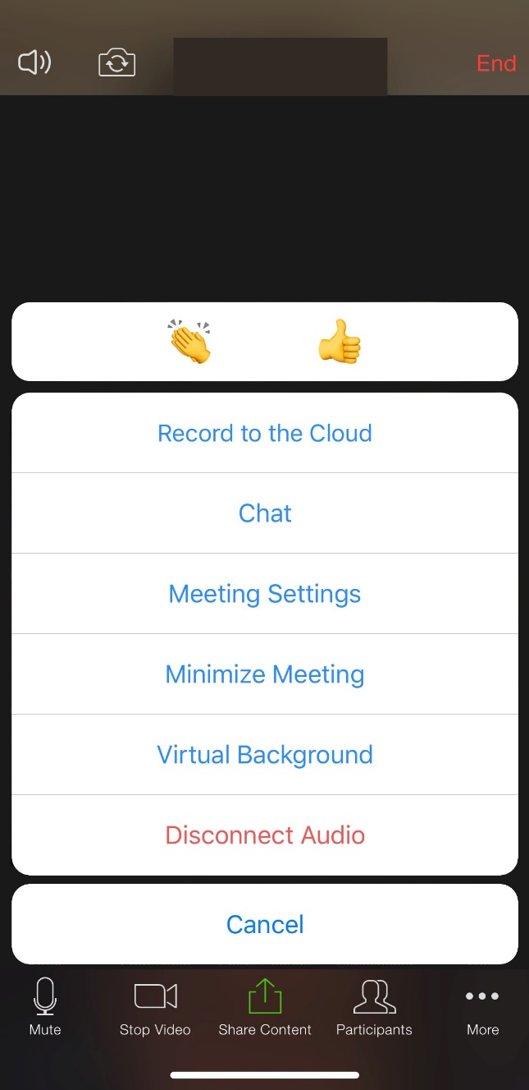
ZOOM MEETING CONTROLS (Tablet & Smartphone)
WHAT TECHNICAL ISSUES SHOULD YOU BE AWARE OFF?
Access the
Chat Window
First, click “More”
Tablet
Smart Phone

Slide 5
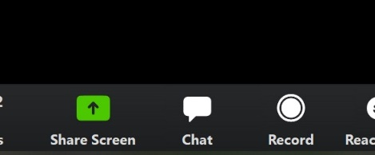
ZOOM MEETING HELP
WHAT TECHNICAL ISSUES SHOULD YOU BE AWARE OFF?
If you have any project-related questions or comments, share them via chat.
For help with how to use Zoom, send a chat message to:
“1_Questions? Ask me!”

Slide 6
Webinar Presentation
WHERE CAN I FIND THIS PRESENTATION?
Today’s presentation can be downloaded here:
https://watertalks.csusb.edu/wp-content/uploads/2022/01/WaterTalks_Webinar_Module_1.pptx
We’re posting the link in the chat box as well!

Slide 7
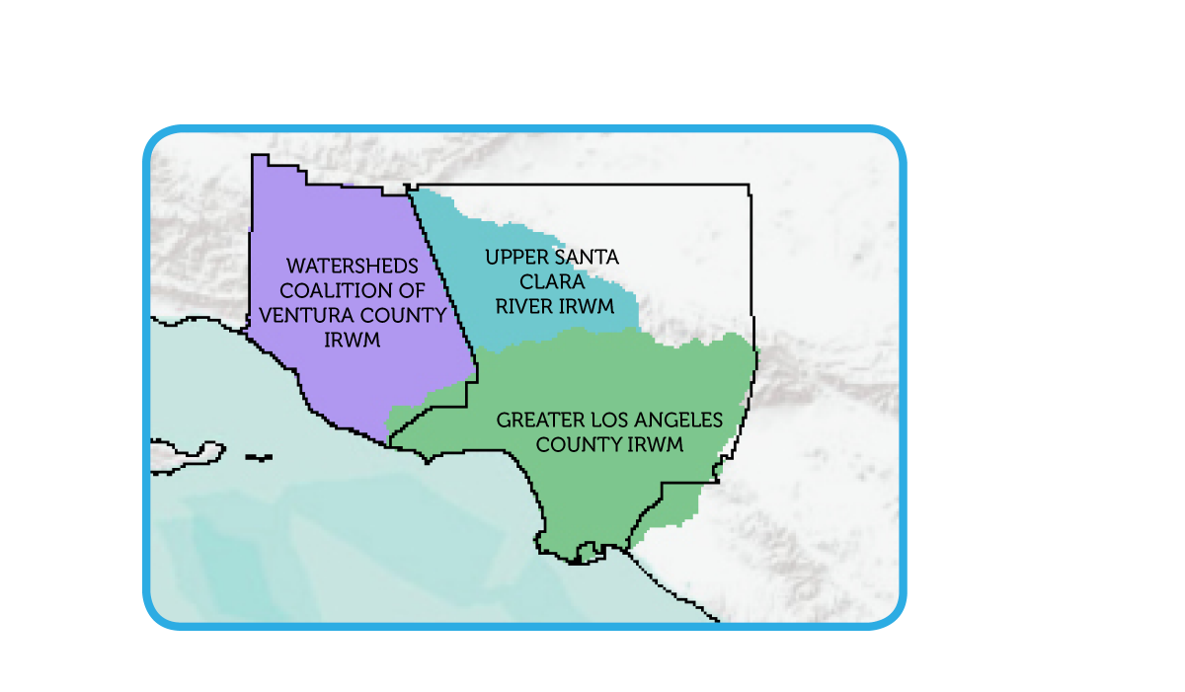
IRWM REGIONS
WHAT IS
IRWM?
Integrated Regional Water Management
Integrated Regional Water Management Planning Act (SB 1672) of 2002
IRWM provides a framework for collaboratively identifying and implementing regional water solutions.
There are three Southern California IRWM Regions in a shared funding area.
Greater Los Angeles County (GLAC)
^{Upper Santa Clara River (USCR)}
Watersheds Coalition of Ventura County (WCVC)

Slide 8
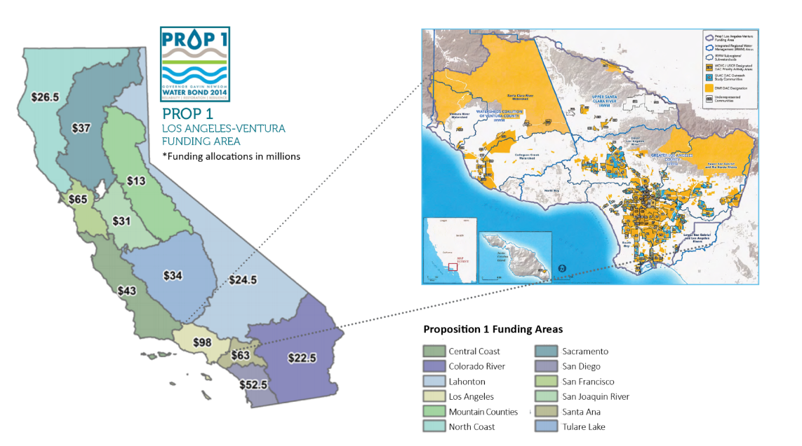
Proposition 1
IRWM Grant
WHAT IS
PROP 1?
^{Where can I learn more?}
Proposition 1: California’s Integrated Regional Water Management, and the Disadvantaged Communities Involvement Program (DACIP), see the following websites:
https://water.ca.gov/Work-With-Us/Grants-And-Loans/IRWM-Grant-Programs/Proposition-1
https://water.ca.gov/Work-With-Us/Grants-And-Loans/IRWM-Grant-Programs/Proposition-1/DAC-Involvement-Program

Slide 9
Disadvantaged Community Involvement Program
WHAT IS DACIP?
A Disadvantaged Community Involvement Program was formed for the three Southern California IRWM Regions to ensure the involvement of:
Disadvantaged communities (DACs),
Economically distressed areas (EDAs),
^{Underrepresented communities}
A DACIP task force was established to:
Facilitate a consensus-based approach to implement the DACIP
Identify community needs and strengths
Build local capacity through technical assistance for project development
$9.8 million dollars of the Prop 1 IRWM Grant for the three Southern California IRWM regions was allocated to these tasks.
Notes:
Disadvantaged Community – a community with an annual median household income that is less than 80 percent of the Statewide annual median household income
Economically Distressed Area – a municipality with a population of 20,000 persons or less, a rural county, or a reasonably isolated and divisible segment of a larger municipality where the segment of the population is 20,000 persons or less, with an annual median household income that is less than 85 percent of the statewide median household income, and with one or more of the following conditions as determined by the department: (1) financial hardship, (2) unemployment rate at least 2 percent higher than the statewide average, or (3) low population density

Slide 10
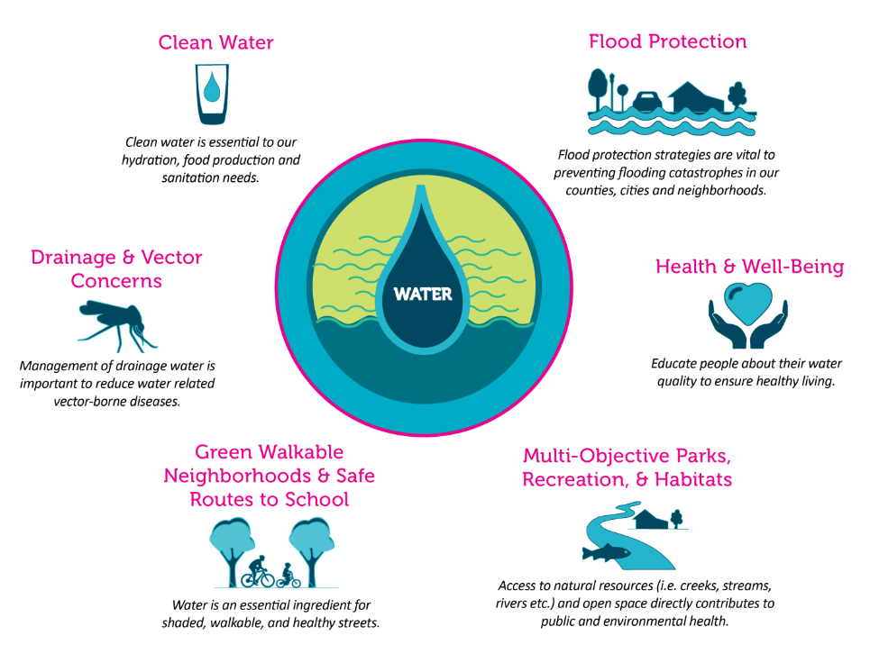
WaterTalks
WHAT IS
WATERTALKS?
As part of DACIP, DAC Consultants in collaboration with NGOs, created the WaterTalks Program.
WaterTalks is a public program to generate and increase community involvement in water management in Los Angeles and Ventura Counties.
^{Learn more at:}
^{watertalks.csusb.edu}

Slide 11
Purpose of this Training
WHAT WILL
YOU LEARN
TODAY?
Today you will learn how to get involved in the IRWM process by:
Generating and Describing Project Ideas
Organizing Community Support
Identifying and Approaching Agencies
Identifying Technical Needs and Resources
Identifying Funding Sources
Navigating Funding Requirements

Slide 12
Purpose of this Training
WHAT WILL
YOU LEARN
TODAY?
There are many different projects that can be funded and many ways to apply for funding.
In the morning session, we are focusing on developing project proposals for many types of funding sources.
In the afternoon session we will take you through submitting proposals using one specific tool.

Slide 13
GENERATING AND DESCRIBING
PROJECT IDEAS
Notes:
Speaker: Boykin

Slide 14
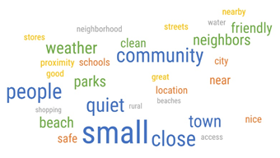
Needs Assessment Report
WHAT WERE
THE STRENGTHS?
The Needs Assessment Report for the WCVC region identified the following community strengths:
^{Strong sense of community}
Greenspace between cities, where many DAC
^{communities tend to recreate}
^{Clean beaches}
^{Social service programs}
^{Local businesses}
Variety of resources, collaborations and strategies for
^{addressing homelessness}

Slide 15
WHAT WERE
THE KEY FINDINGS
FOR COMMUNITY
NEEDS?
Needs Assessment Report
The Needs Assessment Report for the WCVC region identified the following water related issues and opportunities that will help guide the development of project ideas and the selection of projects:
Water contamination due to trash and industrial facilities
^{Drinking water quality}
^{High cost of water}
Water availability for fire suppression and agriculture
^{Access to clean safe water}
Inadequate wastewater collection and treatment
^{Drinking water availability}
^{Recreational water safety}
^{Flooding}
Compliance with new regulatory requirements

Slide 16
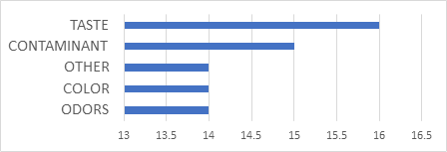
WHAT WERE
THE KEY FINDINGS
FOR COMMUNITY
NEEDS?
Needs Assessment Report
When asked whether there were concerns about drinking water quality respondents answered as follows:
Concerns included the following:

Slide 17
WHAT WERE
THE KEY FINDINGS
FOR COMMUNITY
NEEDS?
Needs Assessment Report
Broader concerns with crossover to water related issues included:
A lack of green space and recreational opportunities
^{Homelessness}
The need for more affordable housing and high paying jobs
Increasing closure of roadways due to flooding and fire, isolating communities
A lack of water storage for use during droughts and fires
The need to reduce and limit development
Notes:
A lack of greenspace: Links the need for recreational space to the need for stormwater BMPs
Homelessness: Deterring encampments in waterways to sidestep surface water contamination
Affordable housing and higher paying jobs: Low wage jobs with increasing cost of housing, utility, and water prices result in increasing DACs over time
Droughts/fires: Increasing stormwater BMPs and groundwater recharge to increase water storage for use during droughts and fires.
Limiting developments : To control the demand for water and to control the need for new infrastructure, hauled water, and other supplementary sources which lead to increases in water rates

Slide 18
IS THE
COMMUNITY
ENGAGING IN WATER
PLANNING?
Needs Assessment Report
Respondents in DAC communities were also asked whether they participated in water related planning in the community:
Community members sited: language barriers, lack of internet service, not having time to attend, no idea who their water provider is or what IRWM is.
And whether they had ideas on how water problems could be addressed:

Slide 19
IS THE
COMMUNITY
ENGAGING IN WATER
PLANNING?
Needs Assessment Report
Of the 618 community members surveyed in Ventura County:
Nearly half agreed that their local government was addressing infrastructure and beautification issues.
Less than a third (30%) of resident respondents in Ventura felt their voices were being heard in community planning.
Less than half (42%) of the Ventura respondents were aware of their water provider.
Additionally, very few (10%) of the respondents in the communities were aware of the IRWM program or any water-related educational programs (11%).
Notes:
Community Survey Questions:
Q. My local government is addressing infrastructure and beautification needs (streets, sidewalks, parks, etc.).
Q. Do you think that community voices or groups are being heard by the government or the public at large?
Q Do you know what drinking water agency provides your water?
Q. Have you ever heard of the Integrated Regional Water Management (IRWM) program?
Q. Do you know what drinking water agency provides you with water?
Q. Are you aware of educational opportunities around water issues locally?

Slide 20
Projects and Programs Identified
WHAT KIND OF
PROJECTS WERE
IDENTIFIED?
Projects and program ideas identified during the DACIP needs assessment process:
Programs that enable local communities to access water-saving programs funded and managed by the State.
Improving resident education and policies that promote water conservation and more ground cover as an alternative to impervious surfaces.
Developing and promoting in-home water filter incentive and tap water testing programs.
More project ideas are included in the Needs Assessment Report:
https://watertalks.csusb.edu/wp-content/uploads/2022/01/Ventura-County-Needs-Assessment-Report_Draft_v_1_28_2022.docx.pdf

Slide 21
Projects and Programs Identified
WHAT KIND OF
PROJECTS WERE
IDENTIFIED?
Projects and Programs continued:
Implementation of more Stormwater Best Management Practices (BMPs).
Dedicating city staff to clean riverbeds more frequently.
Development of programs for affordable septic to sewer conversion.
Assistance to identify and fix leaks within buildings and external infrastructure.
Utilization of old parking lots for more greenspaces.
Utilization of more diverse outreach methods.
Evaluation of water quality and availability on a more regular basis.
More project ideas are included in the Needs Assessment Report:
https://watertalks.csusb.edu/wp-content/uploads/2022/01/Ventura-County-Needs-Assessment-Report_Draft_v_1_28_2022.docx.pdf

Slide 22
DACIP Funded Activity Types
WHAT CAN BE FUNDED BY THE DACIP GRANT?
General Categories | Examples of Activities
Needs Assessments | Survey community members or water providers and facilitate meetings or workshops
Education | Translation or interpretive services for information sharing, water campaigns for community, and education on DAC needs
Community Outreach | Public meetings open to DAC community members and door-to-door outreach
Engagement in IRWM Efforts | DAC regional engagement coordinator role, DAC advisory committee to the WCVC, and DAC representatives in governance
Facilitation | Facilitate WCVC meetings and facilitate project development meetings
Technical Assistance | Public agency/elected official capacity building, facilitation, and agency staff training
Governance Structure | Facilitate, increase DAC involvement in decision making, assess water charges/rate plans, assess consolidation of water providers, and enhancement of DAC aspects of IRWM Plans
Site Assessment | Water quality assessments, median household income surveys, and data and mapping activities
Enhancement of DAC Aspects in IRWM Plans | Development of funding area-wide DAC plans to be utilized as a unified approach for all IRWM plans
Project Development Activities or Construction | Environmental compliance, pre-construction activities, site assessment, grant writing, and project development
Financial Strategy | Provide aid with grant applications

Slide 23
Eligibility for DACIP Funds
WHO IS ELIGIBLE
FOR DACIP FUNDS?
^{Eligible Applicants:}
^{Public agencies}
^{Non-profit organizations}
^{Public utilities}
Federally recognized Indian Tribes
State Indian Tribes listed on the Native American Heritage Commission’s Tribal Consultation list
^{Mutual Water Companies}
For DACIP funding the activities must serve a DAC or EDA.
The mapping tools can be accessed here:
https://water.ca.gov/Work-With-Us/Grants-And-Loans/Mapping-Tools

Slide 24
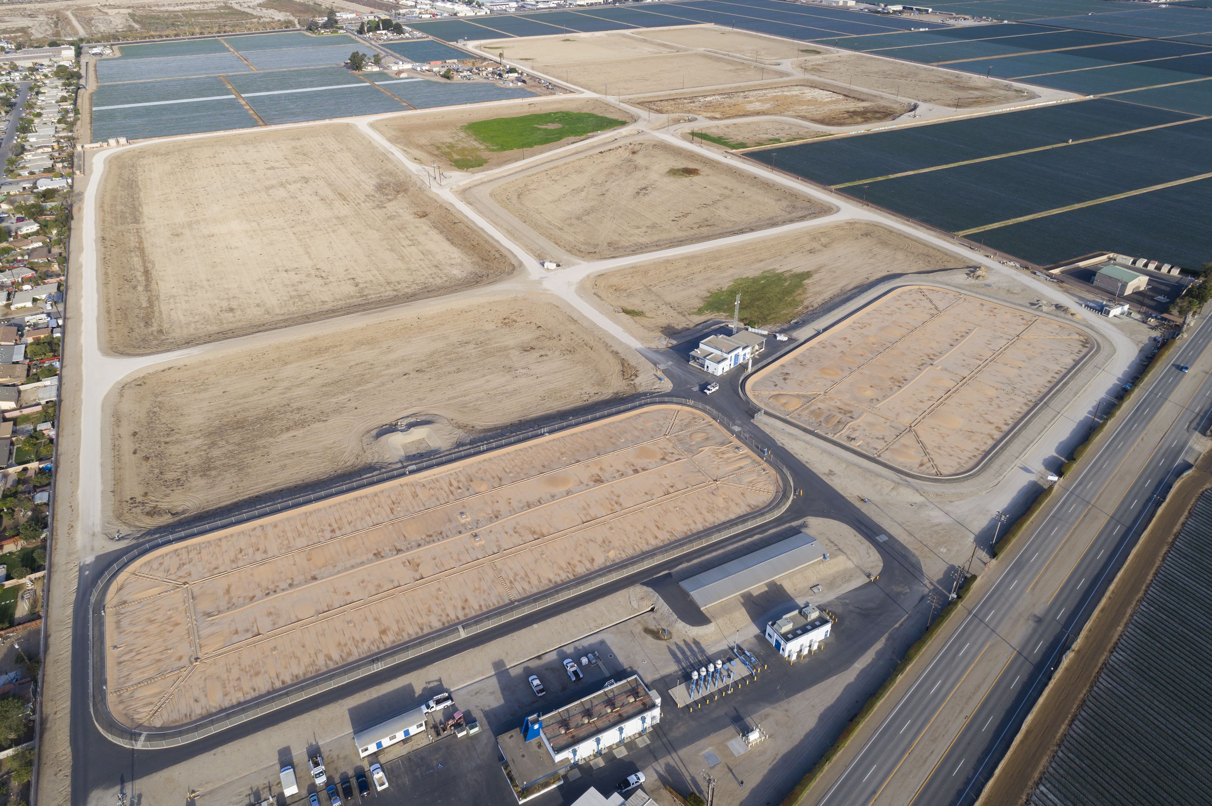
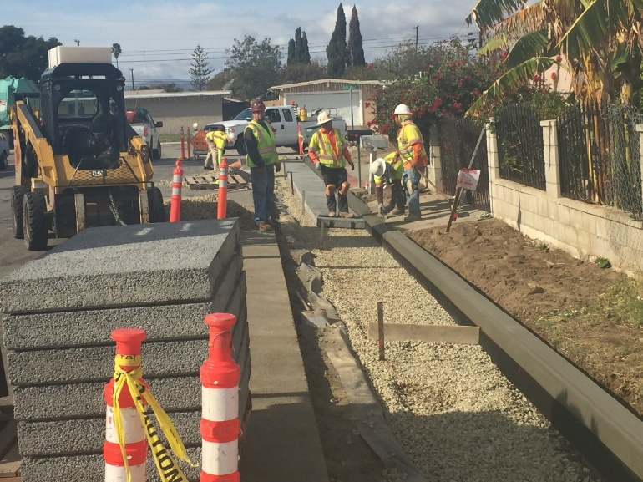
Project Examples PROP 1- ROUND 1 IMPLEMENTATON AND OTHER GRANT FUNDING SOURCES
WHAT KINDS OF PROJECTS HAVE BEEN FUNDED?
Iron and Manganese Treatment Project
United Water Conservation District
El Rio Groundwater Recharge Project
County of Ventura
Notes:
Speaker: Lynn
These are three examples of projects that have been funded by Prop. 1. They are not necessarily located in DACs.
Ask participants to give ideas.

Slide 25
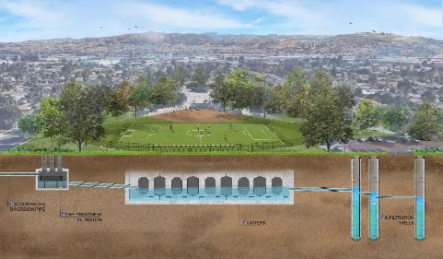
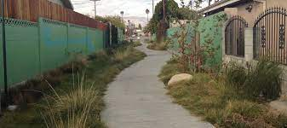
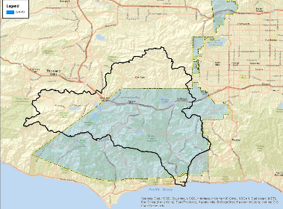
Project Examples Cont’d PROP 1- ROUND 1 IMPLEMENTATON AND OTHER GRANT FUNDING SOURCES
WHAT KINDS OF PROJECTS HAVE BEEN FUNDED?
Elmer Avenue Green Street Project
County of Los Angeles
Allen J Martin Park Stormwater Capture Project
County of Los Angeles
Advanced Metering
Infrastructure Project
Las Virgenes Municipal
Water District
To learn more about previously funded projects, visit:
https://dpw.lacounty.gov/wmd/irwmp/FileList.aspx?path=docs\Round%201%20Implementation%20Grant%20Proposal%20Projects%20Presentation
Notes:
Speaker: Lynn
These are three examples of projects that have been funded by Prop. 1. They are not necessarily located in DACs.
Ask participants to give ideas.

Slide 26
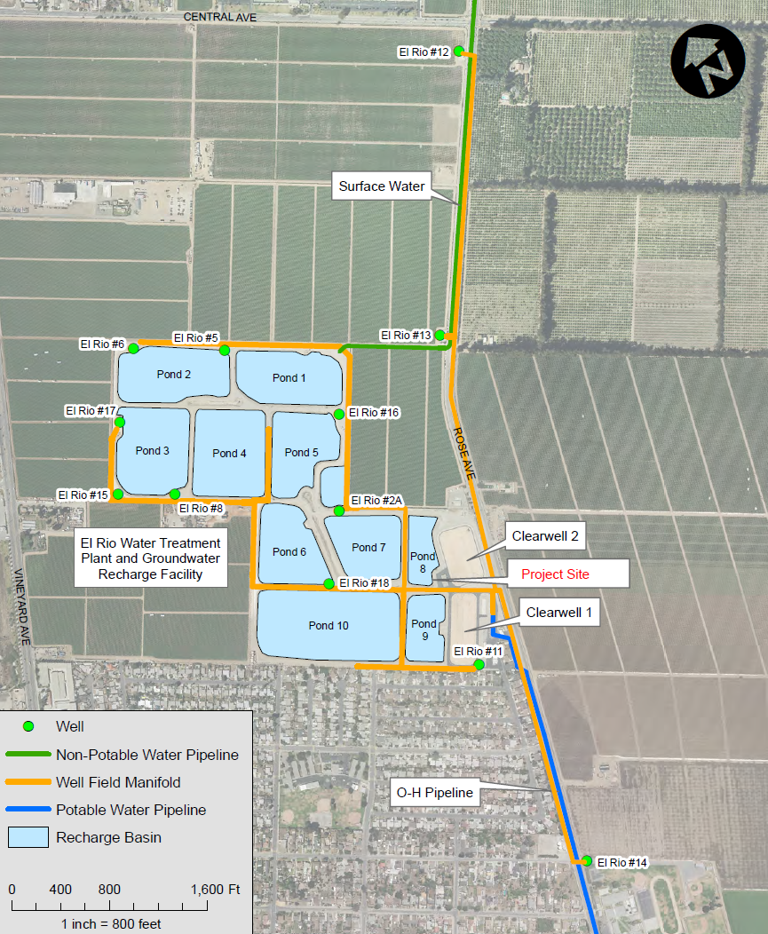
Iron and Manganese Treatment Project United Water Conservation District
EXAMPLE PROJECT PROP 1- ROUND 1
Project Description:
Construct groundwater treatment plant
Goal to improve water for wells in
El Rio wellfield – located in DAC area
Removal of iron and manganese at 3,500
gallons per minute
Funding:
Total project cost - $ 9.58 million
Grant amount - $ 2.5 million

Slide 27
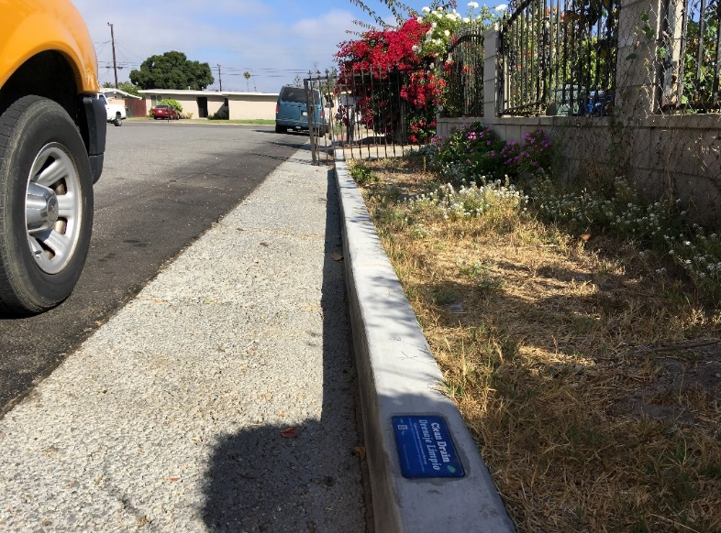
El Rio Groundwater Recharge Project County of Ventura Stormwater Program
EXAMPLE PROJECT PROP 84
Project Description:
Pervious pavement retrofit in road right-of-way and gutters in El Rio
Dry-weather runoff and stormwater from 64 acres of residential area is captured, treated, and infiltrated to groundwater
Improvement of surface water and groundwater quality and floodplain mitigation
Funding:
Total project cost - $1.3 million
Grant funding - $962,001
Lemar
Ave.

Slide 28
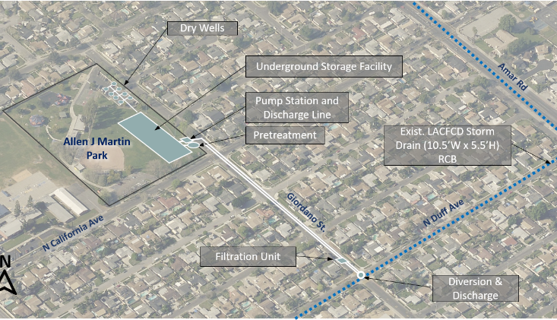
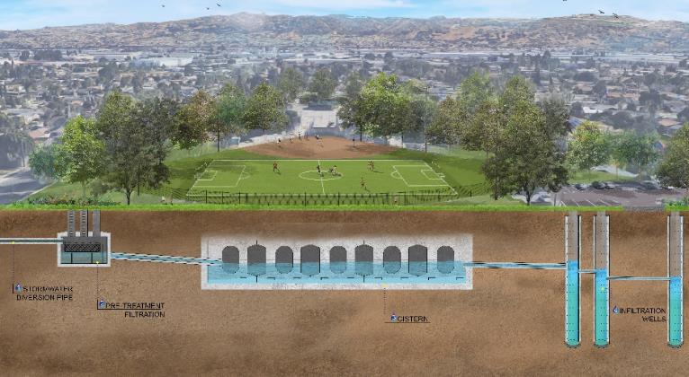
Allen J Martin Park Stormwater Capture Project County of Los Angeles
EXAMPLE PROJECT PROP 1- ROUND 1
Project Description
Stormwater diversion and pre-treatment
Includes 7.1 acre-feet storage vault
8 infiltration wells allows infiltration of 40 acre-feet/year
Funding/Budget
Grant Request: $2M
Matching Funds: $15.7M
Total Estimated Cost: $17.7M

Slide 29
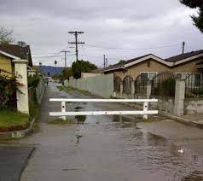
Elmer Avenue Green Street Project
EXAMPLE PROJECT
Funded by City of LA
Prop. O
County of Los Angeles
Project Description:
Captures storm water flow from 20-acre area - diverts runoff to green alley way
Runoff flows onto permeable materials and into bioswales and infiltrates into underground aquifers
Includes drought tolerant plantings and educational signage
Potential to capture, treat and infiltrate 1,300,000 gallons of storm water
Funding/Budget:
Total Cost - $550,000
Funded by City of LA Proposition O and Council for Watershed Health

Slide 30
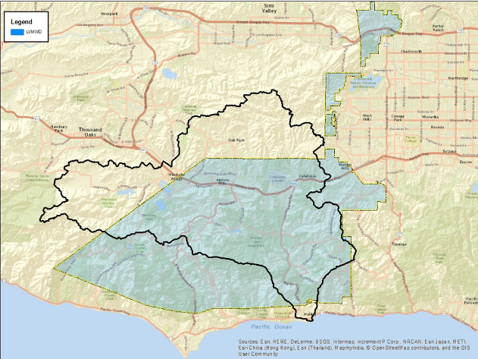
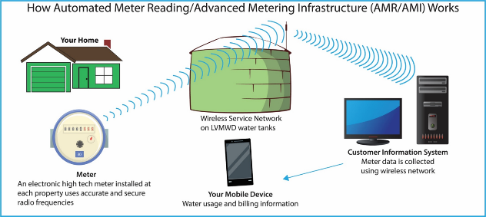
Advanced Metering Infrastructure Project
EXAMPLE PROJECT PROP 1- ROUND 1
Las Virgenes Municipal Water District
Project Description:
Replaces or retrofits approx. 22,000 manually-read water utility meters with Advanced Metering Infrastructure (AMI) or “Smart Meters”
Will automatically relay meter data wirelessly on a continuous basis
Funding:
Funding Request: $1,500,000
Matching Funds: $8,500,000
Total Project Cost: $10,500,000
Notes:
Similar projects in Ventura County

Slide 31
ORGANIZING
COMMUNITY SUPPORT
Notes:
Speaker: Isabelle

Slide 32
Importance of
Community Support
WHY IS
COMMUNITY SUPPORT
IMPORTANT?
Once a project idea is conceptualized it is important to plan for community outreach.
^{Community support is:}
An ongoing process and should continue throughout the project
Creates an opportunity for diverse stakeholders to come together
Essential for gathering input from the community
Essential for keeping the community appraised of progress
Essential for identifying resources and developing relationships
Notes:
Presenters should ask about:
- Experiences participants have had with community outreach efforts and what they consider successful practices

Slide 33
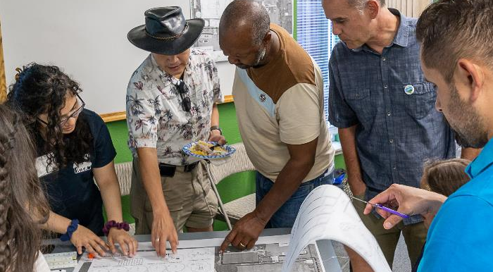
Importance of
Community Support
WHY IS
COMMUNITY SUPPORT
IMPORTANT?
^{Benefits of Community support:}
Projects with community support have an easier time with roll out
Community input can inform project proponents of successful outreach practices
Gives project proponents a better understanding of local needs, strengths, and concerns
Notes:
Presenters should ask about:
- Experiences participants have had with community outreach efforts and what they consider successful practices

Slide 34
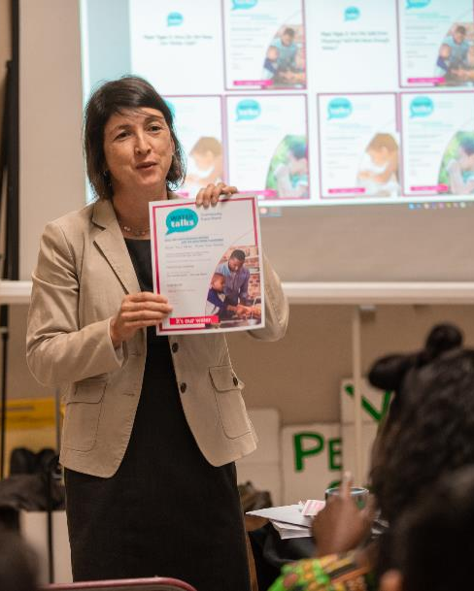
Stakeholders
HOW TO
DO OUTREACH?
Community outreach should include:
Publicly noticed or informal outreach and education events with multiple stakeholders:
Local DAC focused community organizations
Leaders in educational institutions
Churches or faith-based institutions
Health/social/legal service providers
^{Business organizations}
Elected and other local government representatives
^{Members of the public}
^{Water/wastewater providers}

Slide 35
Outreach Tools
HOW TO
DO OUTREACH?
Community outreach tools include:
Community-based education materials
^{Door-to-door outreach}
Signs and pamphlets at the library, community center, etc.
A trusted on-the-ground community member to champion the project
^{Virtual meeting}
Notes:
Presenters should ask:
Which of these tools' participants have had experience with and which they feel works best.
Do they know of more tools?

Slide 36
Community Support
Available Resources
WHO CAN
HELP WITH THIS?
Community outreach can be accomplished:
In collaboration with a local agency, NGO, CBO, or technical assistance group
These entities will typically have:
An outreach program/procedures that can be catered to specific projects
Knowledge of the local community, key issues and concerns
Existing relationships that can be leveraged and built on
Possible familiarity with IRWM planning
IRWM DACIP funding could also be used to conceptualize and roll out a community outreach program
Notes:
Presenters should ask:
- What local agencies and/or NGOs/CBOs participants are familiar with

Slide 37
IDENTIFYING AND
APPROACHING AGENCIES
Notes:
Speaker: Lynn

Slide 38
Importance of Agency Collaboration
WHY IS AGENCY
COLLABORATION
IMPORTANT?
Agencies can assist with:
Community support
Data collection
Site/needs assessments
Project development
Identifying funding sources
Filling out grant applications
Agencies can collaborate with multiple other agencies and nonprofits.
Collaborations enable resource needs to be identified and resolved quicker.
It is crucial for community members to collaborate with a trusted agency.
Notes:
Agencies can assist with:
Community support: facilitate meetings/workshops, disseminate information, launch a targeted campaign etc.
Data collection: survey community members, water sampling, soil sampling etc.
Site/needs assessments: mapping, rates assessment, system maps etc.
Project development: Environnemental Compliance, site plans, design plans, planning and environnemental permits
Identifying funding sources
Filling out grant applications
Provide letters of support

Slide 39
Identifying Agencies
WHICH AGENCIES
CAN HELP?
Examples of agencies that can help:
State and Federal Agencies
Local water provider
Wastewater district
Countywide Agencies
Stormwater quality program
Local municipality
Resource Conservation District
Notes:
Speaker: 3
Presenter should ask attendees:
“What kind of projects or ideas would you go to the local water provider with?”
“What kind of projects would you go to the wastewater district with?”
“What kind of projects would you go to the flood control district with?”
Field examples from the audience

Slide 40
Water Service Providers
WHO CAN
HELP WITH
WATER RELATED
PROJECTS?
Some of the Water service providers that serve DACs include:
Casitas Municipal Water District | Piru Mutual Water Company
Casitas Mutual Water Company | Rancho Sespe Workers Imp. Assoc.
City of San Buenaventura Water Works | California American Water
Aliso Mutual Water Company | Alta Mutual Water Company
Oxnard City Water Services | Rio Plaza Water Company Inc
Cloverdale Mutual Water Company | The Mutual Water Company of Vineyard Ave. Estates
Rio Manor Mutual Water Company | Vineyard Ave. Acres Mutual Water Company
City of Santa Paula | Farmers Irrigation Company
Teague-Mckevett Division - Limoneira | City of Fillmore - Water Dept
Fillmore Irrigation Company | Fillmore West Trailer Park
Rio Manor Mutual Water Company | Vineyard Ave. Acres Mutual Water Company
Strickland Mutual Water Company | Alta Mutual Water Company
Garden Acres Mutual Water Company | Nyeland Acres Mutual Water Company
Oxnard Water Department | United Water Conservation District
Cypress Mutual Water Company | Dempsey Road Mutual Water Company
For a full list of Ventura County water purveyors please visit:
https://s29422.pcdn.co/wp-content/uploads/2018/08/WaterPurveyors_Web.pdf
^{To find your water provider:}
https://watertalks.csusb.edu/who-is-my-water-service-provider

Slide 41
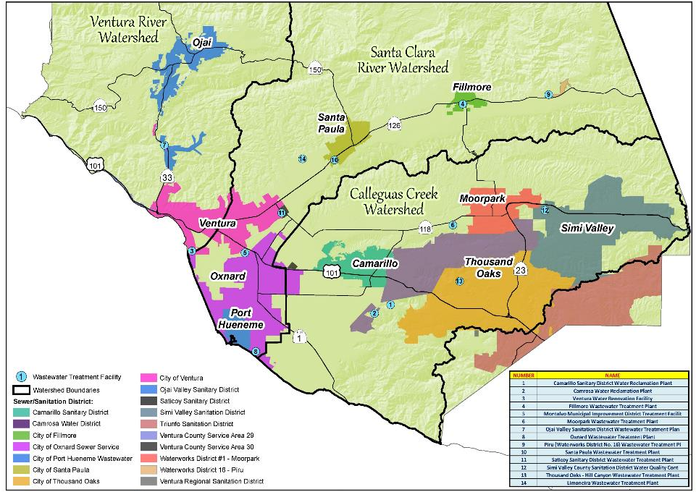
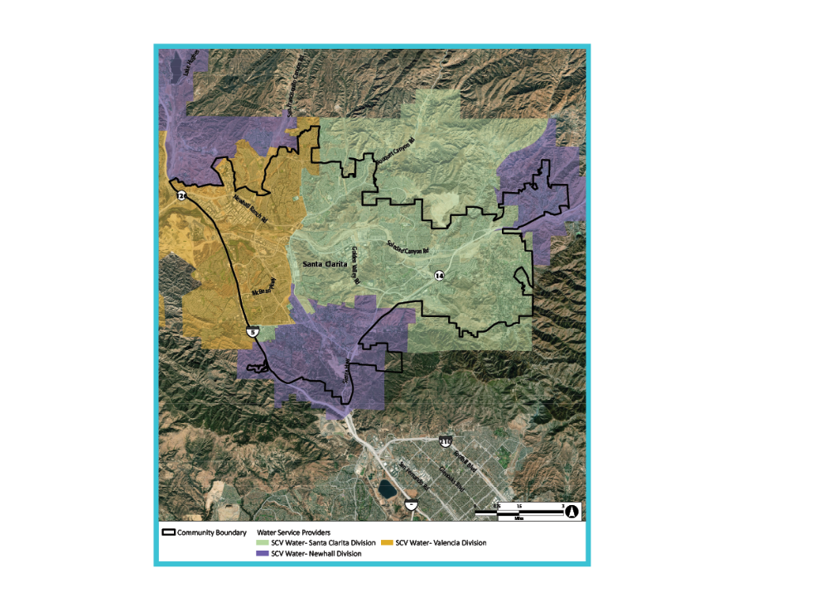
Wastewater Districts
WHO CAN HELP
WITH WASTEWATER
PROJECTS
17 Wastewater Districts serve our communities including the following that serve DACs:
^{City of Santa Paula}
^{City of Ventura}
^{Saticoy Sanitary District}
^{City of Oxnard Sewer Service}
^{City of Filmore}
^{Ojai Valley Sanitary District}
^{Waterworks District 18 – Piru}
^{City of Oxnard Sewer Service}

Slide 42
Water and Wastewater Service Providers
WHO CAN
HELP WITH
WATER RELATED
PROJECTS?
Water service providers can assist with projects related to:
^{Water quality projects}
^{Water supply projects}
Improving physical and emergency water infrastructure
Water challenges associated with droughts
Wastewater districts can assist with projects related to:
Improving physical and emergency sewer infrastructure
Addressing overflows during storms

Slide 43
Other Agencies
WHO CAN HELP
WITH OTHER
TYPES OF PROJECTS?
^{Ventura County:}
^{Public Works Agency}
^{Flood Control District}
^{County Continuum of Care}
^{Watershed Protection District}
^{Stormwater Quality Program:}
Ventura Countywide Stormwater Quality Management Program
^{Local municipalities:}
Public works departments (City of Ventura, Oxnard, Santa Paula etc.)
Resource Conservation District:
^{Ventura County RCD}
^{For more information on these}
^{agencies please visit:}
^{https://www.vcstormwater.org/}
^{https://www.venturacoc.org/}
https://www.vcpublicworks.org/wp/
^{https://www.vcstormwater.org/}
https://www.cityofventura.ca.gov/189/Public-Work
https://www.oxnard.org/city-department/publicworks/
https://spcity.org/205/Public-Works
^{https://vcrcd.org/}
Notes:
Public Works Department: can help with infrastructure projects (pumping stations, replacing old well/pipes, inspection program etc.)
Flood Control District: can help with assessing where flooding is coming from, possible flood solutions etc.
Watershed Protection District: can help with stormwater BMPs, natural habitat restorations, greenspace projects etc.
Ventura Countywide Stormwater Quality Management Program: can help with implementation of structural and non-structural stormwater BMPs
Ventura County RCD: irrigation evaluations, agricultural management measures etc.

Slide 44
Approaching Agencies
HOW TO APPROACH
AN AGENCY?
Once the best agency is identified, approaching an agency could involve:
Identifying who at the agency to talk to:
By finding a community member to make an introduction
Asking your elected city council member or County Board of Supervisor’s staff to help you connect with the right agency staff member
Small mutual companies may not have employees, a website or an office
Larger agencies will have staff, a website and contact details online
Unincorporated communities: Contact the local water service provider/utility - or the appropriate County Supervisor if that isn’t successful
Incorporated cities: Call the city water utility - or a City Council Member if that isn’t successful
Be able to discuss your project, what you need, who's supporting your project. Advocate for your project.

Slide 45
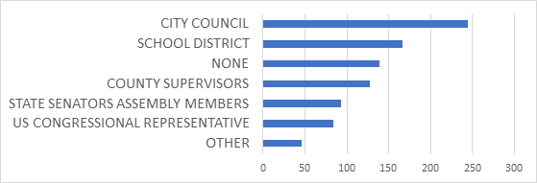
Approaching Agencies
WHAT AGENCIES DO DAC MEMBERS GET THEIR INFO FROM?
When community members were asked what governing entities and/or elected officials they seek information from or receive information from they responded with the following:

Slide 46
IDENTIFYING
TECHNICAL NEEDS AND RESOURCES
Notes:
Speaker: Holly

Slide 47
Identifying Technical Needs
WHAT DO I NEED
TECHNICAL
ASSISTANCE FOR?
Technical needs vary according to the type of project. Examples include:
^{Water Quality Needs:}
The type of water testing, what should be tested, what lab to use, how to collect samples etc.

Slide 48
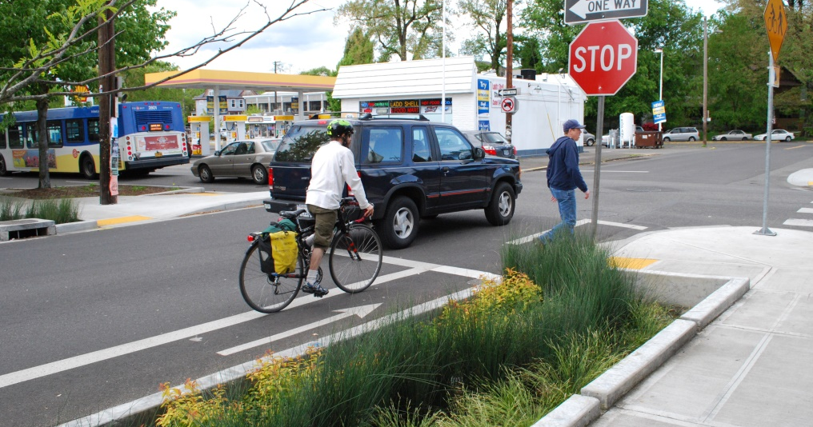
Identifying Technical Needs
WHAT DO I NEED
TECHNICAL
ASSISTANCE FOR?
Stormwater Project: Assessing site specific geology for infiltration projects, groundwater conditions, drainage area and existing storm drain system, collecting site-specific data such as soil and infiltration testing, mapping drainage area, selecting a preliminary design etc.

Slide 49
Identifying Technical Needs
WHAT DO I NEED
TECHNICAL
ASSISTANCE FOR?
Water Supply Project: Feasibility studies (to assess options), engineering plans, designs specifications, permits, environmental compliance, regulatory requirements etc.

Slide 50
Identifying Technical Assistance Groups
WHO CAN
HELP WITH
TECHNICAL
ASSISTANCE?
Technical resources can be identified through collaborations with technical assistance groups and/or local agencies such as:
County partnerships for infrastructure projects
State Water Board’s Office of Sustainable Water Solutions
State agencies (Regional Water Quality Control Boards)
Water Resources & Policy Initiatives (WRPI) at California State University
California Rural Water Association
Rural Community Assistance Corporation
^{Community Water Center}
^{Local agencies}
^{Resource Conservation District}
IRWM DACIP funding could also be used for technical assistance needed to conceptualize a project.

Slide 51
IDENTIFYING
FUNDING SOURCES
Notes:
Speaker: Lynn and Lara

Slide 52
Identifying Funding Sources
WHAT GRANTS CAN
YOU APPLY FOR?
Organizations that can help with identifying funding sources include:
All the Technical Assistance Groups previously mentioned
Resources that can help with identifying funding sources include:
Funding Navigation for California Communities
US EPAs Clearinghouse for Environmental Finance
^{California Grants Portal}
California Financing Coordinating Committee (CFCC)
For more information visit:
https://www.fundingresource.org/
https://ordspub.epa.gov/ords/wfc/f?p=165:1:7509890781617
https://www.grants.ca.gov/
https://cfcc.ca.gov
Notes:
The grants.ca.gov is the best place to go to.
CFCC has a compendium.

Slide 53
Identifying Funding Sources
WHAT GRANTS CAN
YOU APPLY FOR?
Primary funding sources include
Proposition 1 funding: IRWM - DAC and non-DAC grants
^{State Water Board Programs}
Department of Water Resources Programs
California Environmental Protection Agency
Strategic Growth Council Programs
Federal Emergency Management Agency (FEMA) BRIC
(Building Resilient Communities)
For more information visit:
https://sgc.ca.gov/programs/

Slide 54
Proposition 1: Non-IRWM Funding
WHAT TYPES OF PROJECTS CAN BE FUNDED?
Prop 1 Non-IRWM Funding Programs Administered by State Water Board
Program accepts applications on an ongoing basis
Application requirements vary by program
Programs:
Small Community Wastewater (all funds allocated)
Water Recycling
Drinking Water
Storm Water
Ground Water
Where can I learn more?
https://www.waterboards.ca.gov/water_issues/programs/grants_loans/proposition1.html
Select “Current Funding” tab on this page
Notes:
If your community’s project is not selected to receive TA or does receive TA but does not receive further funding, there are other Prop. 1 funding opportunities that you may want to look into.
The State Water Resources Control Board has five programs funded by Prop 1 that are open to projects in all types of communities in the State.
The first of these programs, Small Community Wastewater, is now complete and is not accepting further applications.
The other four programs accept applications on an ongoing basis, with requirements varying by program.

Slide 55
OTHER FUNDING SOURCES
WHERE ELSE CAN WE GET FUNDING?
State Water Board has a variety of other grant programs, including:
Division of Financial Assistance Drought Funding
Prop 68 Groundwater Treatment and Remediation Grant Program
Clean Water State Revolving Fund
Drinking Water State Revolving Fund
Underground Storage Tanks Cleanup Fund
Stormwater Grant Program
Cleanup and Abatement Account
Non-point Source (NPS) Pollution Control Program
Where can I learn more?
https://www.waterboards.ca.gov/water_issues/programs/grants_loans/
Select “Current Funding” tab on this page
Notes:
Other funding sources, beyond Prop. 1, include a variety of programs run by the State Water Board
Each of these programs has different requirements and you can learn more about them at the website listed on the slide. These programs are not necessarily restricted to DAC communities.

Slide 56
OTHER FUNDING SOURCES
WHERE ELSE CAN WE GET FUNDING?
Department of Water Resources has many grant programs, covering:
Environmental Restoration
Flood Related
Ground Water
Integrated Regional Water Management
Water Quality or Drinking Water
Water Supply or Management
Water Use Efficiency
Where can I learn more?
https://water.ca.gov/Work-With-Us/Grants-And-Loans
Notes:
The Department of Water Resources also has many funding programs for a variety of project types.

Slide 57
OTHER FUNDING SOURCES
WHERE ELSE CAN WE GET FUNDING?
USDA Rural Development offers water & waste disposal loans & grants in rural areas in California
California Environmental Protection Agency offers a variety of grants, including Environmental Justice Small Grants
California Natural Resources Agency offers bonds and grants for creek, stream, and river parkway enhancements and flood protection
^{Where can I learn more?}
https://www.rd.usda.gov/programs-services/water-environmental-programs/water-waste-disposal-loan-grant-program/ca
https://calepa.ca.gov/envjustice/funding/
https://resources.ca.gov/grants
Notes:
Other funding sources include CalFire, which has community forestry grants that include water-related co-benefits
CalEPA uses Cap and Trade funds for grants to DAC, including environmental justice small grants

Slide 58
Accessing DAC Funds through WATERTALKS
HOW CAN WATERTALKS HELP FUND MY PROJECT?
WaterTalks Outreach
Outreach Round 1
(Summer 2019-Spring 2020)
Objective: Educate and Inform
IRWM Region staff selects Round 3 Projects*
Outreach Round 3
Objective: Technical assistance to develop project proposals
Outreach Round 2
Objective: Assess needs and identify projects
WaterTalks Outreach Events
Project Proposals
Project Selection
PROP 1 IRWM Grant
Funding Process*
IRWM staff assists with funding source identification
Implementation of Funded Projects
(Not all projects will be funded)
Notes:
*DAC funding is limited and is NOT guaranteed for any project
Notes:
Speaker: Boykin
WaterTalks consists of three rounds of outreach, with a final goal of submitting a community-generated project for funding consideration.
As part of Round 2, communities will be asked to identify projects for submittal to IRWM Region Staff. These submitted projects will be evaluated by IRWM Region Staff and some will be selected to receive technical assistance to develop into full project proposals.
Projects receiving this technical assistance can be submitted for Prop 1 IRWM DAC project funding and can also be submitted by the community for funding from other sources. The WCVC DAC Committee will review and approve the project list – as well as the Steering Committee and General Membership.
Communities with projects that are not selected for proposal development during Round 3 will receive information from IRWM about identifying other potential funding sources.
As a reminder, funding for Technical Assistance is not guaranteed and not all projects that receive TA will receive funding for implementation.

Slide 59
Track 1: Ventura Request for Proposals Timeline
WHERE ELSE CAN WE GET FUNDING?
Second RFP notification
Deadline for proposals
Review date (tentative)
Notification
Sent
Date COB: 2/18/22
Date : 3/07/22
Date: 3/09/22
Date: 1/18/22
Notes:
Other funding sources include CalFire, which has community forestry grants that include water-related co-benefits
CalEPA uses Cap and Trade funds for grants to DAC, including environmental justice small grants

Slide 60
Track 2: Urban and Multi-benefit Drought Relief Funding
WHERE ELSE CAN WE GET FUNDING?
Project Identification
Project Selection
Project Submission for funding
Notification
Date: Currently underway
Date: 2/25/22
Approximate Date : 3/04/22
Date: Pending
Notes:
Other funding sources include CalFire, which has community forestry grants that include water-related co-benefits
CalEPA uses Cap and Trade funds for grants to DAC, including environmental justice small grants

Slide 61
Track 3: IRWM Round 2 Funding
WHERE ELSE CAN WE GET FUNDING?
Project Identification in Conjunction with Track 1
Project Due Date
Project Selection
Date: Currently underway
Approximate Date: Sept 22
Date : Pending
Date: Pending
Notification
Notes:
Other funding sources include CalFire, which has community forestry grants that include water-related co-benefits
CalEPA uses Cap and Trade funds for grants to DAC, including environmental justice small grants

Slide 62
WATERTALKS
NAVIGATING FUNDING REQUIREMENTS
OUR TAP WATER

Slide 63
Funding Requirements
WHAT DO
FUNDING AGENCIES
USUALLY REQUIRE?
Different funding sources have different requirements; however, the following is usually required when submitting a proposal for funding:
Budget: high level budget, which includes staff hours, rates, contractors, materials and supplies, O&M costs if allowed
Scope of work: project description, task breakdown, deliverables, management/coordination activities
Schedule: milestones, start and end date, schedule narrative justifying timespans – ability to complete project within grant timelines
Fund-specific paperwork requirements
Ability to conduct environment review (required by the California Environmental Quality Act (CEQA) in a timely manner
Description, and possible quantification, of benefits

Slide 64
Contacts
WHO CAN ANSWER MY QUESTIONS?
County of Ventura
Lara Shellenbarger - Lara.Shellenbarger@ventura.org
Lynn Rodriguez - Lynn.Rodriguez@ventura.org
PlaceWorks
Isabelle Minn - iminn@placeworks.com
Dina El Chammas Gass - delchammas@placeworks.com
Spence Koehler – skoehler@placeworks.com
CSUSB
Boykin Witherspoon - BWithers@csusb.edu
Melissa Moreno - Melissa.Moreno2@csusb.edu
Miranda Moore - Miranda.Moore@csusb.edu
California Rural Water Association
Holly Alpert - halpert@calruralwater.org
CSUN
Ben Chou - ben.chou@csun.edu

