Slide 1
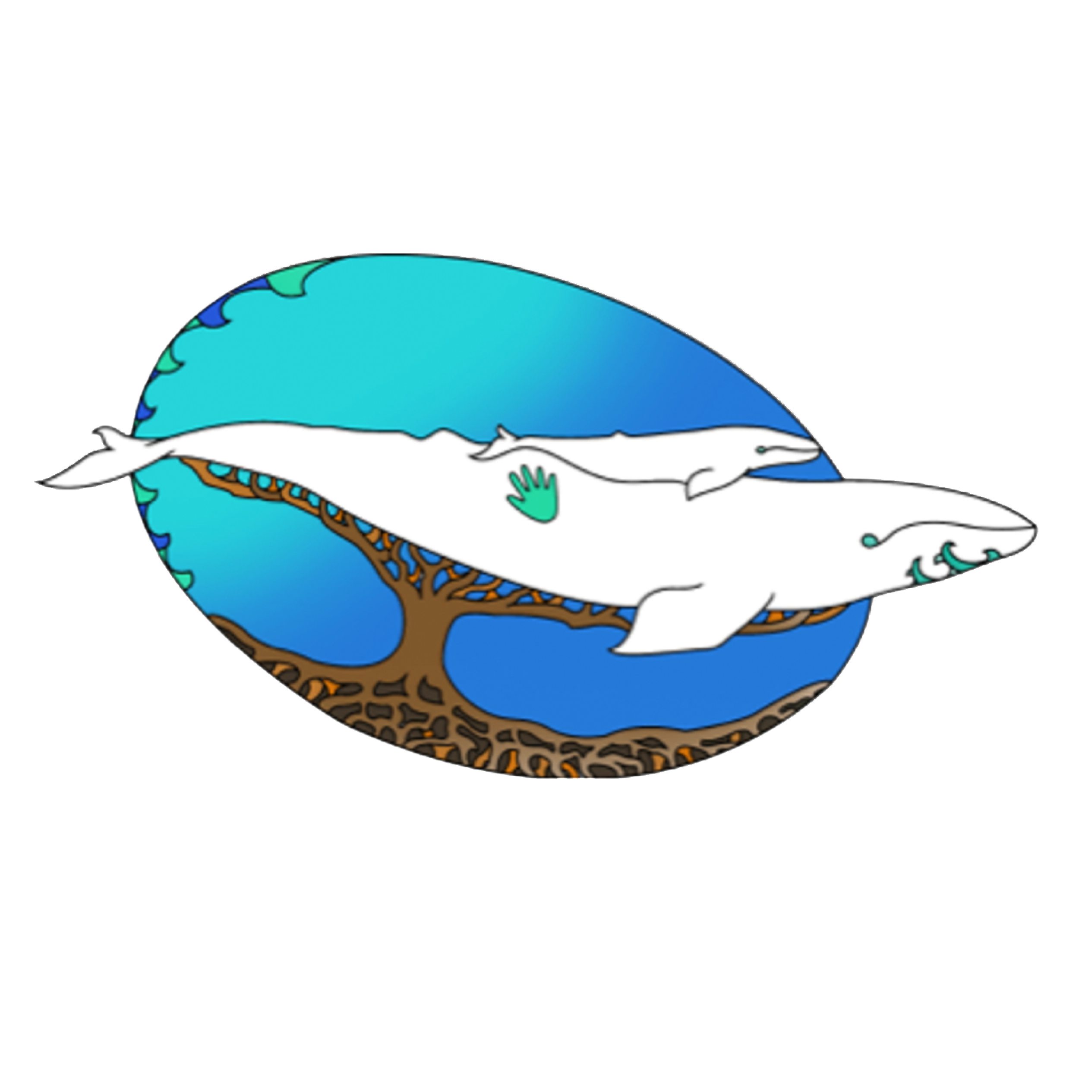
Upper Santa Clara River Region Agency Training Workshops

Slide 2
Grounding and Land Acknowledgment
Map of Native Land in California
Notes:
Gabriella

Slide 3
Community Agreements
Keep an open mind and heart
One mic, be respectful and allow others to finish their thoughts
Be mindful of the space your are taking
Use Raise Hand button if you wish to speak
Be conscious of Intent vs Impact
Dismantling systems of oppression benefits everyone
Liberation is possible
Give credit where it is due
Be your own Boo
Notes:
Maritza

Slide 4
Agenda
Introductions
SPI and TreePeople
Water, Culture, & Origin: Providing Indigenous Context
Capitalism, Settler Colonialism, Commodification, and Contamination
Working with Native Nations & Indigenous Peoples Today
Allyship
Closing

Slide 5
SPI and Tree People
SPI Mission Statement
TreePeople Mission Statement
TreePeople inspires and supports the people of Southern California to come together to plant and care for trees, harvest the rain, and renew depleted landscapes.
Born from the efforts of a teenager over 40 years ago, we have involved more than 3 million people in planting and caring for more than 3 million trees.
We unite with communities to grow a greener, shadier and more water-secure city at homes, neighborhoods, schools and in the local mountains. We work with volunteer leaders using our unique Community Forester model, and we influence government agencies for a healthy, thriving Southern California.
Sacred Places Institute for Indigenous Peoples (SPI) is located on the southern California coast in the unceded ancestral homelands of the Tongva people. Our mission is to build the capacity of Native Nations and Indigenous Peoples throughout California, the United States, and around the world to protect sacred lands, waters, and cultures. Our long-term goal is to create paradigm shifts that support environmentally and socially just systems and assure the continuation of Indigenous cultures and people.

Slide 6
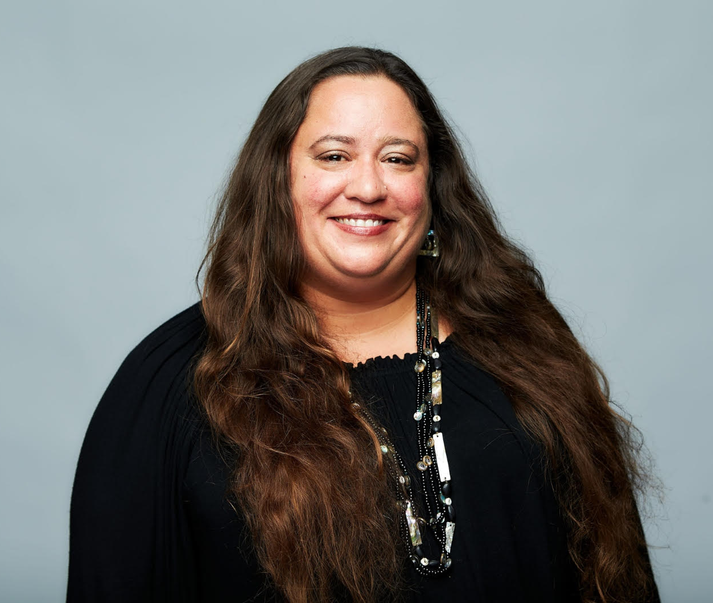
Angela Mooney D’Arcy
Angela is from the Acjachemen Nation, Juaneno Band of Mission Indians. Angela was born in her ancestral homelands whose traditional territories include the area now known as Orange County and raised in the ancestral homelands of the Osage, Kaw and Wichita Peoples. She has been working with Native Nations, Indigenous Peoples, grassroots and nonprofit organizations, artists, educators and institutions on environmental and cultural justice issues for nearly twenty years. She is the Executive Director and Founder of Sacred Places Institute for Indigenous Peoples, an Indigenous-led, grassroots environmental justice organization dedicated to building the capacity of Native Nations and Indigenous Peoples to protect sacred lands, waters, and cultures. She co-founded the United Coalition to Protect
Panhe, an alliance of Acjachemen people dedicated to the protection of the sacred site Panhe and served on the Board of the Blas Aguilar Adobe Museum & Acjachemen Cultural Center for nearly a decade. She received her B.A. from Brown University and her J.D. with a concentration in Critical Race Studies and focus on federal Indian law from University of California, Los Angeles School of Law. She currently lives and works in unceded Tongva homelands now known as Los Angeles, California

Slide 7
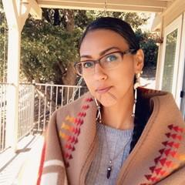
Jessa Calderon
Jessa Calderon Indigenous Waters Program & Ocean Protectors Program Director, Sacred Places Institute for Indigenous Peoples
Jessa Calderon is the Coordinator of Indigenous Oceans and Waters Protector Programs for Sacred Places Institute. Jessa is of the Tongva and Chumash Nations which are original peoples in Southern California. They are a paddler on the ocean with Chumash relatives, which holds a deep and sacred meaning to their heart. Jessa’s journey is to protect the ocean and all bodies of life including other water sources, plants, and people.

Slide 8
Gabriella Lassos
Gabriella is Gabrielino Tongva. She has lived in her ancestral homelands for most of her life and from a young age has known of her heritage but was never able to truly learn and interact with tribal members outside of her immediate family. As someone who is still learning about their tribal heritage, Gabriella has taken on a position with Sacred Places Institute for Indigenous People to work with various programs including the Indigenous Waters Program, Sacred Ecologies Program and the Indigenous Youth Environmental Justice Program. Her position within the organization has allowed her to learn so much about her indigenous relatives and how to advocate for other indigenous folx.

Slide 9
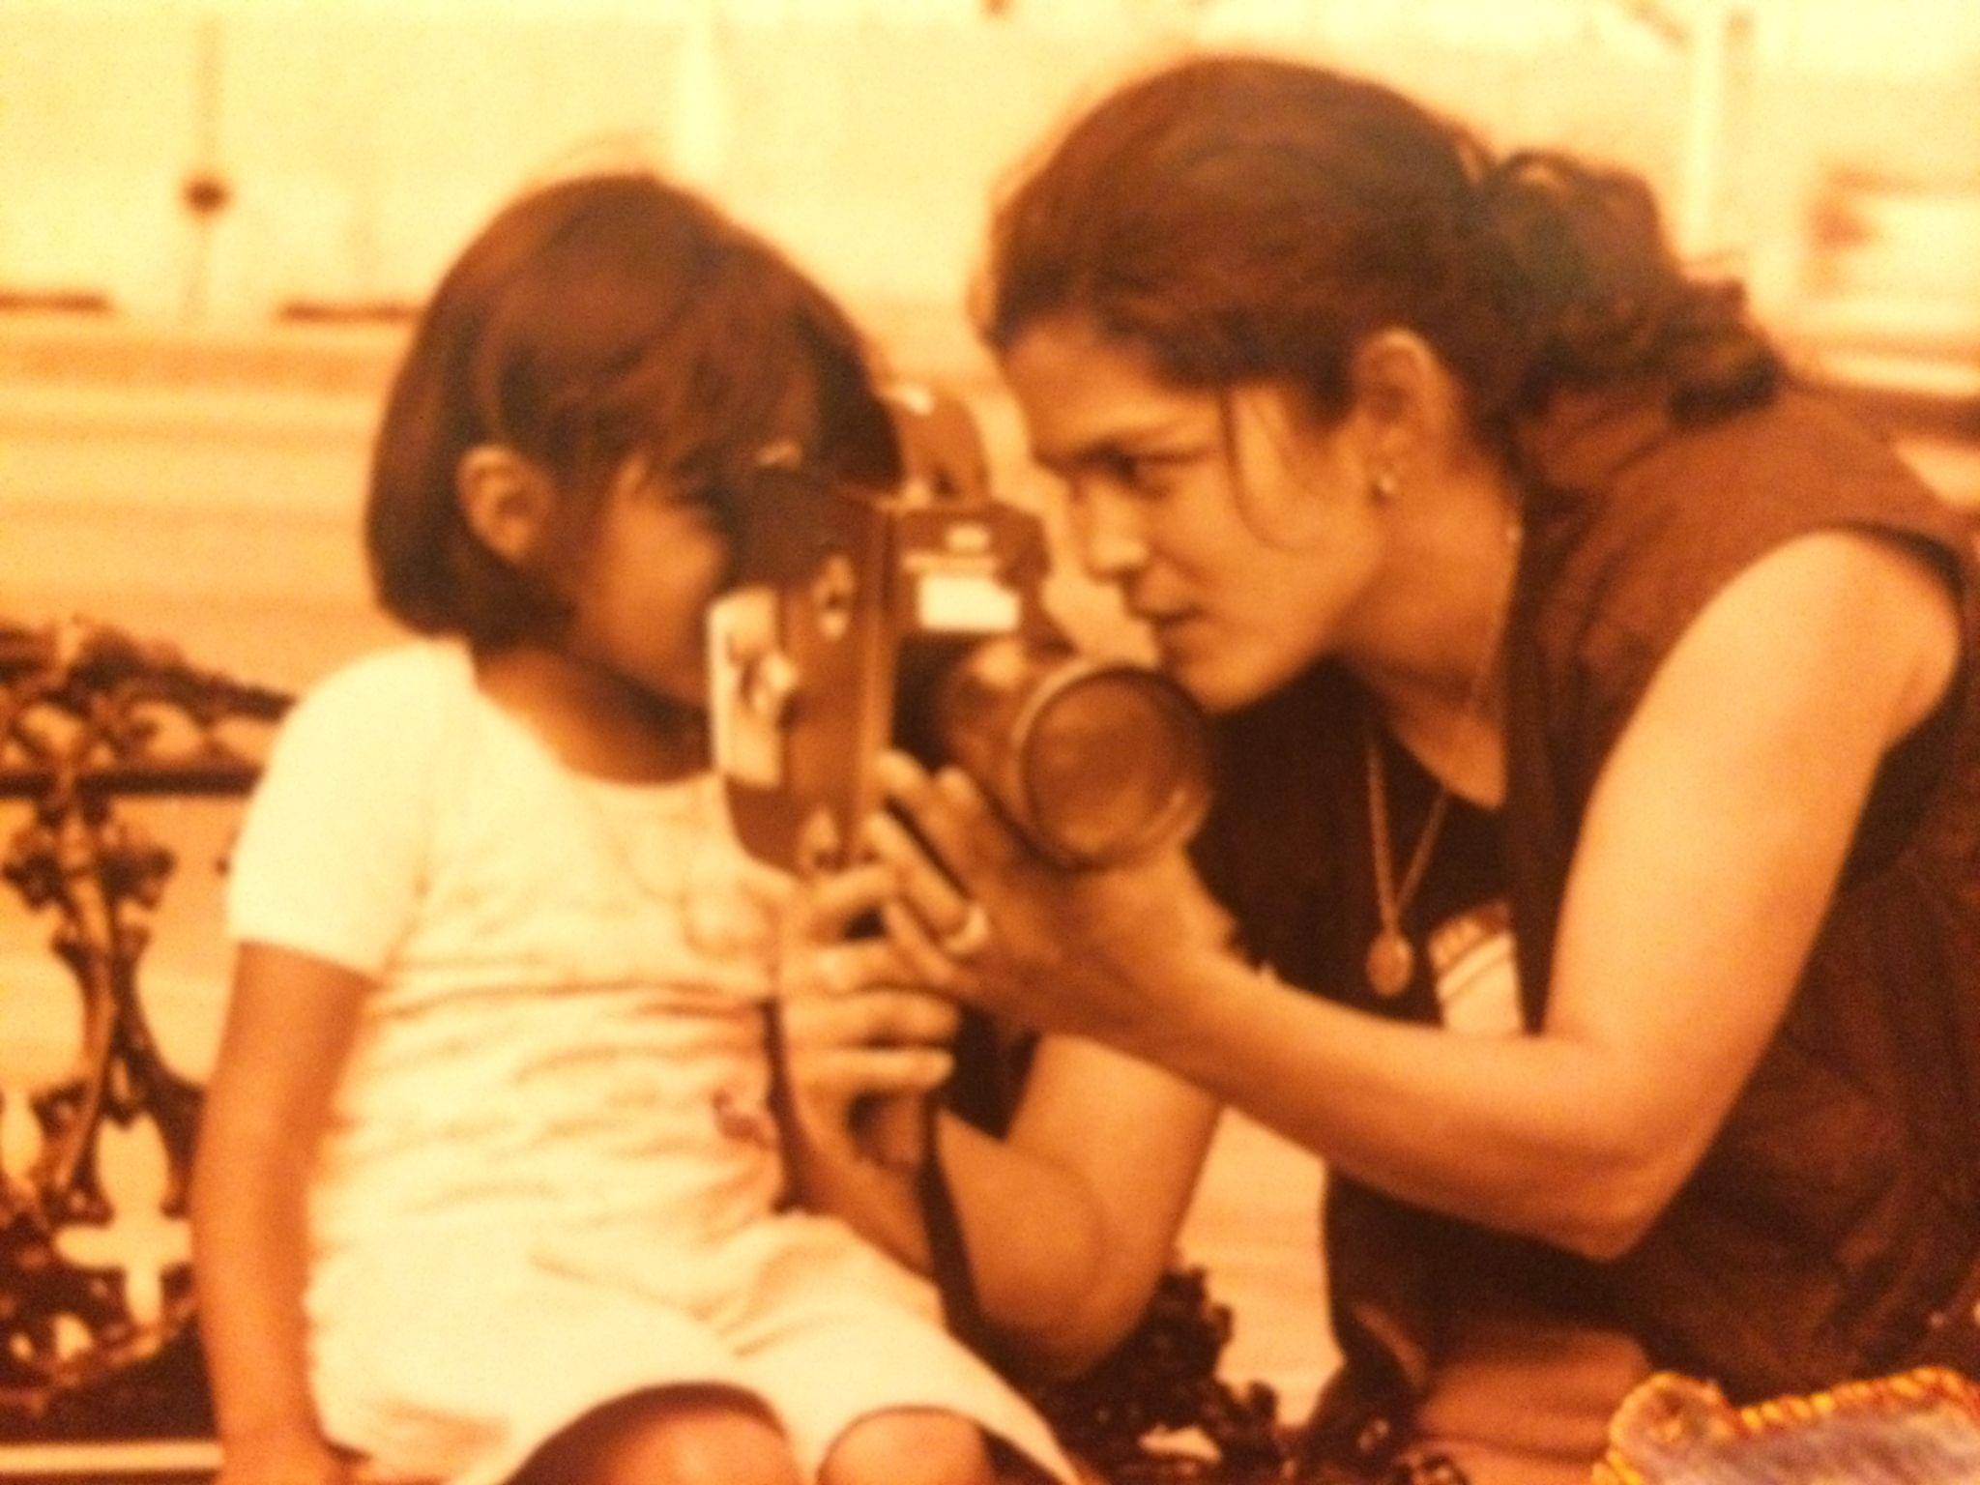
Maritza Alvarez
Maritza Alvarez is a queer, detribalized Xicana with Indigenous roots in western Mexican territories. At an early age she was formally trained as a community organizer, spearheading successful campaigns for the Center for Third World Organizing, Communities for a Better Environment and other grassroots movements. Following her undergraduate work at U.C. San Diego she embarked into guerrilla filmmaking, (screenwriter/cinematographer) merging her activists work with film. Most of her work focused on the documentation of Pan Indigenous movements through Aba Ayala. Some of those projects included the general sessions at the United Nations on the Declaration on the Rights of Indigenous Peoples (UNDRIP), the South Central L.A. urban farm struggle, the 13 Indigenous Grandmothers Gatherings and countless others. She currently works for the SPI media, water and energy team and resides in the unceded Tongva traditional territories.

Slide 10
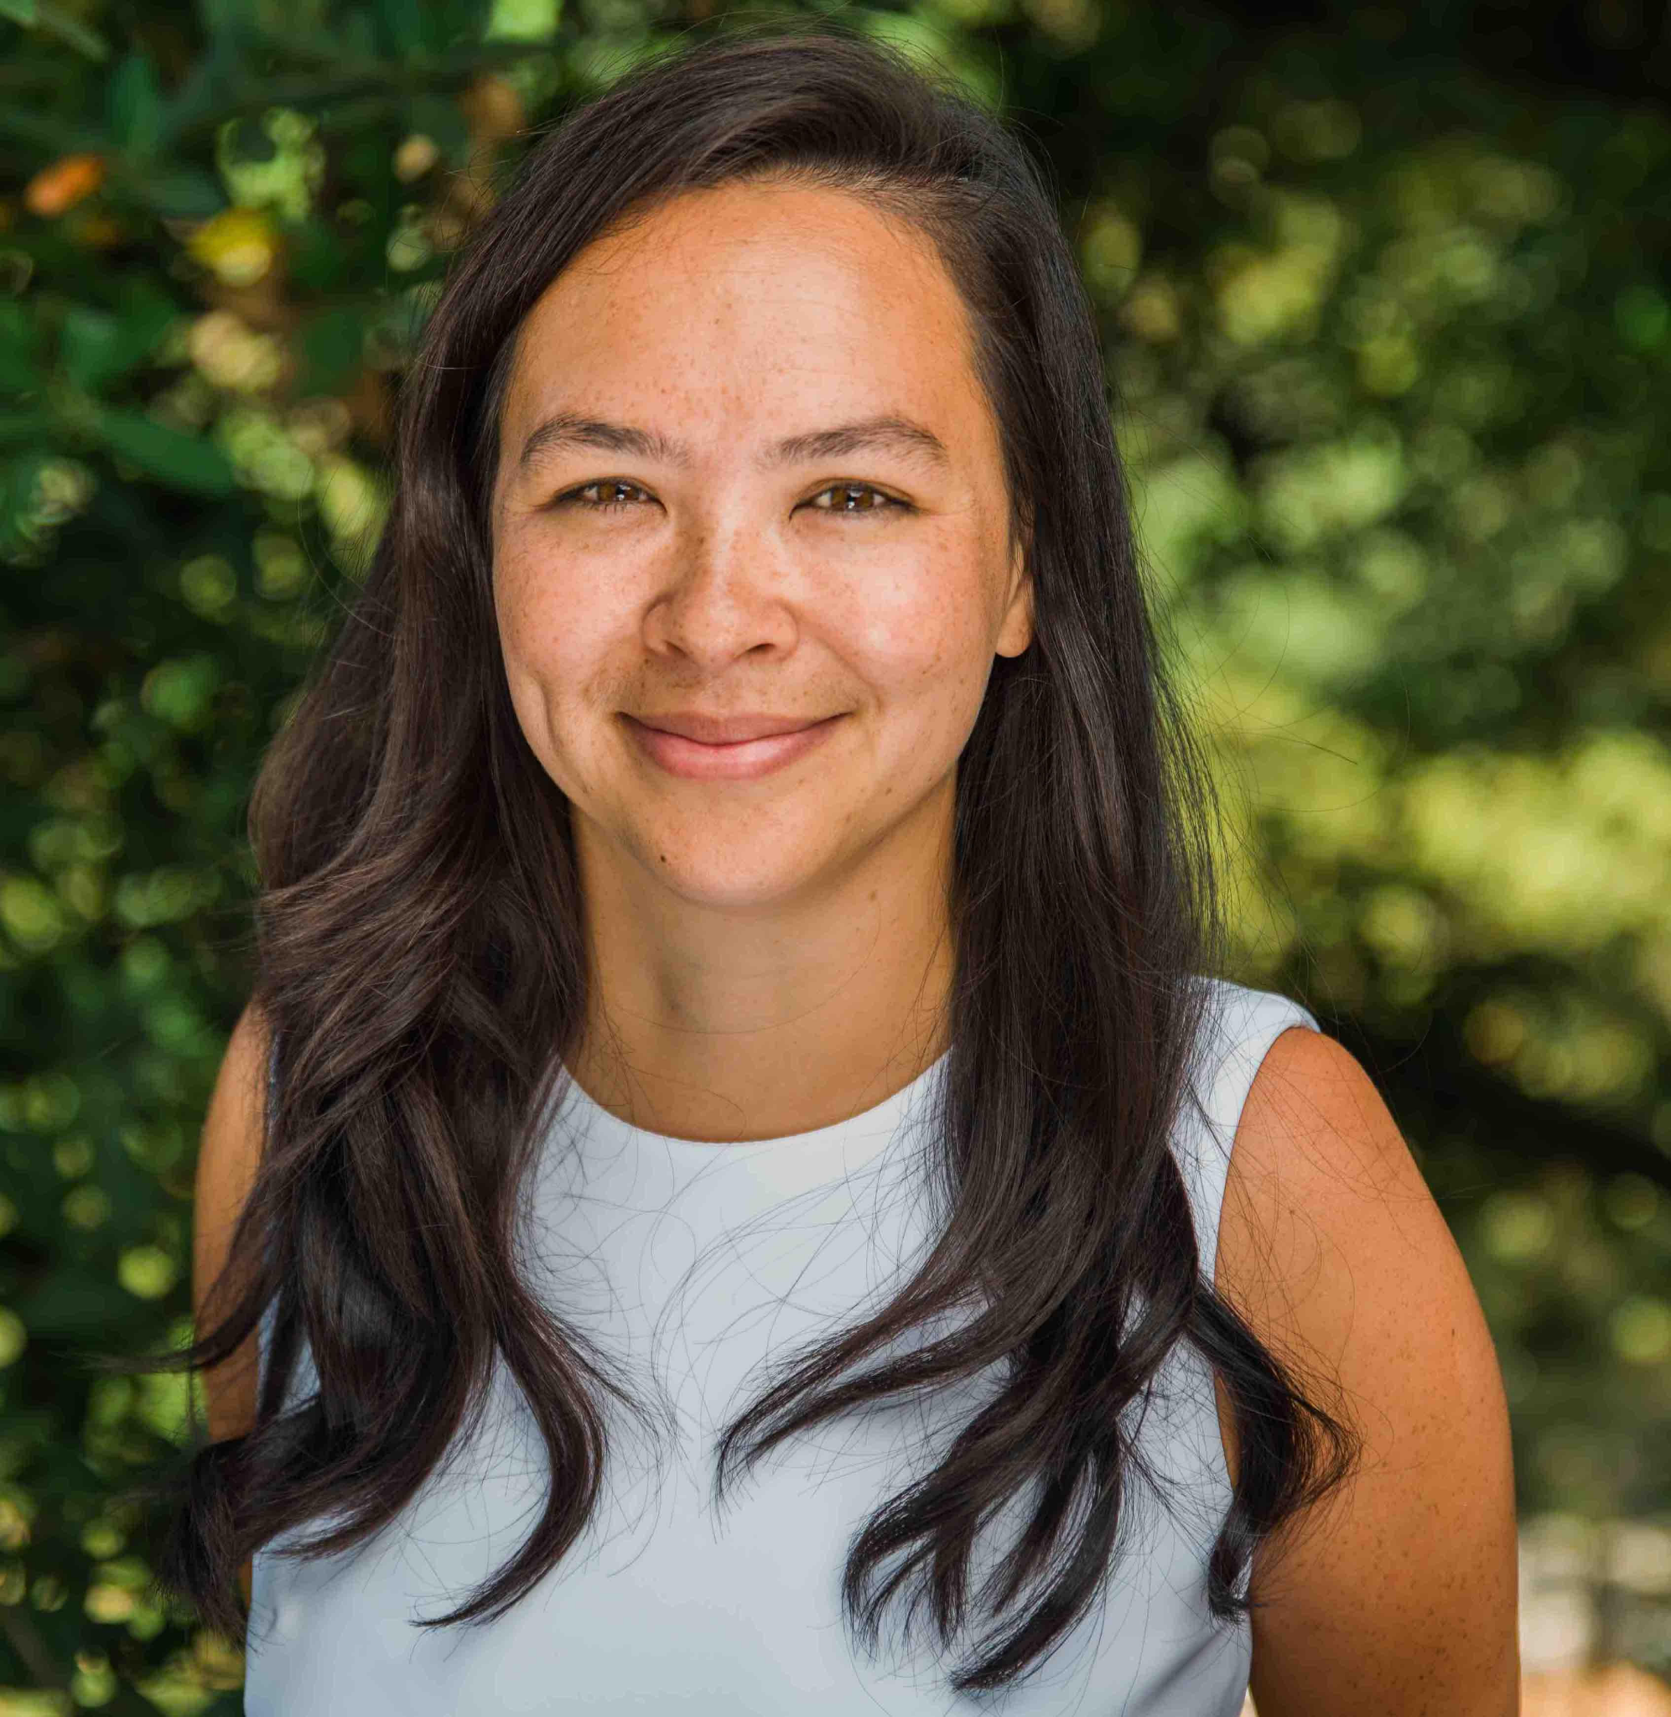
Ariel Whitson
Ariel Lew Ai Le Whitson, Director of Education and Community at TreePeople, leads and manages TreePeople’s environmental education, water equity and urban greening community organizing departments. Her teams mobilize community-members across Southern California, with a focus on environmentally and economically stressed communities who have faced historical environmental injustice, in actively participating in initiatives focused on climate change solutions, reforestation, water security, fire resilience, urban soils and planting a healthy urban tree canopy. This includes supporting teachers and youth to take action in their communities through hands-on, science-based activities. She has extensive experience in managing programmatic and legislative initiatives, fundraising, and marketing campaigns. She also serves on the Board of Literacy for Environmental Justice.

Slide 11
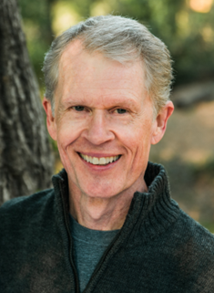
Peter Massey
Peter Massey, Project Manager, Water Equity Programs, has more than 20 years’ experience in non-profit administration, with a special focus on public fundraising, contract administration, project and program design, partnerships and strategic planning. Peter currently lead’s TreePeople role as on-call consultant to LA County Dept. of Public Works for implementation of the WaterTalks Program, developing water projects and programs in both unceded and underrepresented areas of Los Angeles and Upper Santa Clara River regions. Since May of 2021, Peter also serves as a Watershed Coordinator for LA County’s Safe, Clean Water Program for the Santa Clara River Watershed.

Slide 12
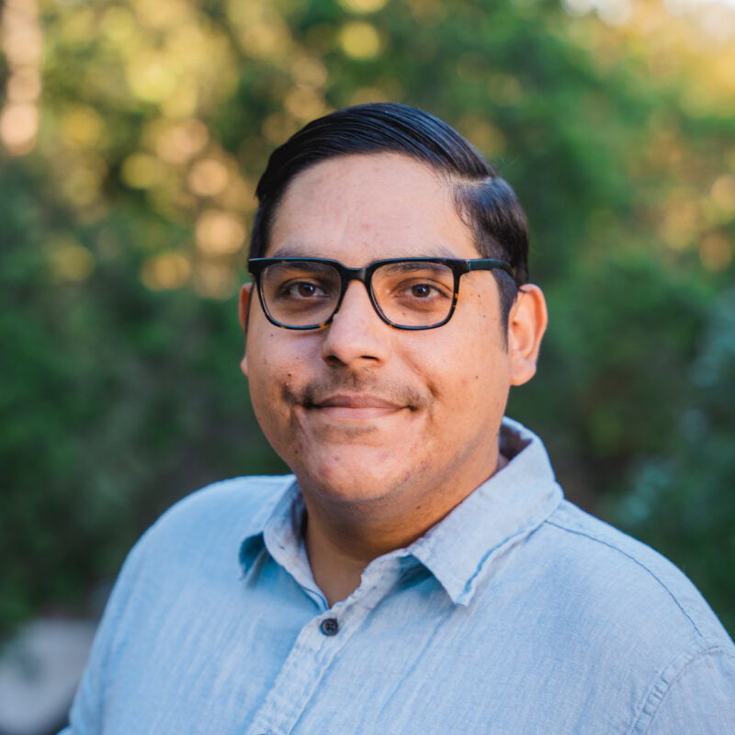
Roland Pacheco
Roland is the Tribal Engagement Coordinator for TreePeople. Roland is of the Acjachemen Nation. Raised and lives on the traditional land of the Tongva Peoples in Whittier, California. Growing up in a family proactively involved in Indigenous community efforts in the East Los Angeles area, Roland has expanded on his involvement and understanding of Indigenous community efforts introduced to him as a child. Having worked in the water realm at the municipal and community levels, Roland is working on being able to further elevate the Indigenous voices in the community with his familiarity of water systems. His position in the organization has helped lead to reconnect with parts of his community.

Slide 13
Water, Culture,& Origin
Providing Indigenous Context
Notes:
Jessa

Slide 14
Locating Ourselves
The Santa Clara River stems from the waters of the San Gabriel Mountains
The River was shared between the Chumash and the Tataviam Nations as they both had villages near the river
There were no borders involved, both Nations traveled up and down stream as needed
Both Nations relied on and contributed to a healthy ecosystem to sustain life
https://www.tataviam-nsn.us/history/#Timeline

Slide 15
Water as a Living Entity
Water is an energy source
Life in the River
salmon, trout, animals that we lived off of and within
What are some of the ways that you practice respecting water?
Can you describe what water as a living entity means to you?
Can you describe what water as an energy source means to you?
include in chat
Notes:
Indigenous people understand that the land/waters have always had it’s natural cleansing and healing system. Rocks, pebbles, sand and plant roots contain energy which give the water healing qualities. The rocks, pebbles, sand, dirt and plant roots are a natural cleansing system. The rocks, sand, roots and water are a place for many species of life to thrive. When the damming occurs it creates stagnancy, the water’s natural cleansing system is removed causing the water to become easily infected with disease such as deadly algae and causing the natural life such as fish to die off. When contaminants are poured into the water it also causes disease causing death and harm to any living beings who rely on the water source.

Slide 16
Relationships and Reciprocity
Relationship between plants, roots, rocks, pebbles to the dirt to the sand and how they all tie in to natural cleansing systems and work together
Responsibility as human beings–our responsibility to care for plants and river
Maintaining healthy relationships
Understanding the power and importance of vibration and intention
Taking only what is needed
Notes:
Jessa
Our people knew that vibration was an important part of life. Every form of life is vibrating and tuning into vibrations causing different reactions. When one has good and loving intentions, they release good and loving vibrations outside of themselves. The intention or prayers going into paddling the river ways, bathing and drinking the energetically charged and natural systematically cleansed water, collecting food in or near the water, collecting materials for common uses, was all a contributing factor to maintaining a healthy vibrating ecosystem. We all sang to each-other and kept the loving vibrations high and pure. We all had good intention behind our actions and made sure to do our part in keeping one another healthy. Take only what you need has been a teaching we still live by today. When people came here with the intention to steal, kill and take with mal intent and bad vibrations, the healthy ecosystem as we knew it began to shift into the sick ecosystem we surround ourselves with today. It’s not enough to talk about it like the partner who’s sorry with promises to change tomorrow. It’s beyond time to get back to the practices. Although we are far behind to revitalizing the practice of healthy relationship and reciprocity, if we continue to make excuses as if we could never get back there meanwhile continuing to over indulge and over develop we will surely completely devastate our homelands.

Slide 17
Questions?

Slide 18
Capitalism, Settler Colonialism, Commodification, and Contamination
Notes:
Gabriella

Slide 19
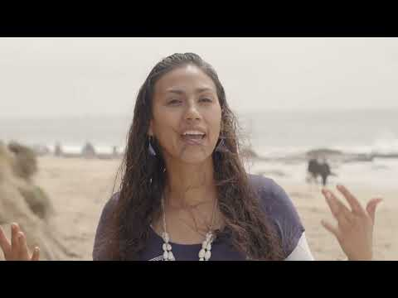
Indigenous Voices on Sacred Waters
State agencies play an important role in the connection between water and people.
Allowing indigenous people, especially those from local tribes, to have co-management opportunities allows the public to see that Indigenous people are not a thing of the past
Meaningful consultation and co-management is so much more important than the performative kind that a lot of agencies currently engage in
It allows for trust between tribes and agencies to be built
Notes:
Isaiah?

Slide 20
Modification of the River
The river has been denaturalized for the benefit of settlers.
Bridges, housing complexes and silt mining in the upper portion of the river have a direct impact to all of the river
Construction along the river in the Santa Clarita Valley has been highly contested by Indigenous Peoples and environmentalists due to the negative impact it has on the river, flora and fauna of the area
Notes:
matillija dam

Slide 21
Where Does your Water Come From?
It’s important to know where your water comes from so that you can properly show respect to the water itself
Keep in mind that the water is not willingly flowing into your home, it is being forced to do so because of the infrastructure that is in place
Reconnection with water will help you understand why its is sacred and not something we should be wasting

Slide 22
Questions?

Slide 23
What is one thing that rises to the top for you based on what you’ve heard so far?
What reflections do you have on water based on our current drought situation in California?
How do you, or how would you like to reconnect with water?
BreakOut Rooms

Slide 24
Working with Native Nations and Indigenous Peoples Today

Slide 25
Honoring Our Ancestors & Building Relationships for the Future

Slide 26
Working with Tribal Communities–Historical Context
Origin Stories: Before there was California-Indigenous Peoples Here Since the Beginning of Time
The Native peoples of California | Map by Timara Lotah Link, who adds: “Although many Native people in California lost their lives and cultures during the Mission and Gold Rush eras, they are reviving their languages, continuing their cultural traditions, and teaching us about this place we call home.” Tending the Wild, What John Muir Missed: the Uniqueness of California Indians, available at https://www.kcet.org/shows/tending-the-wild/what-john-muir-missed-the-uniqueness-of-california-indians

Slide 27
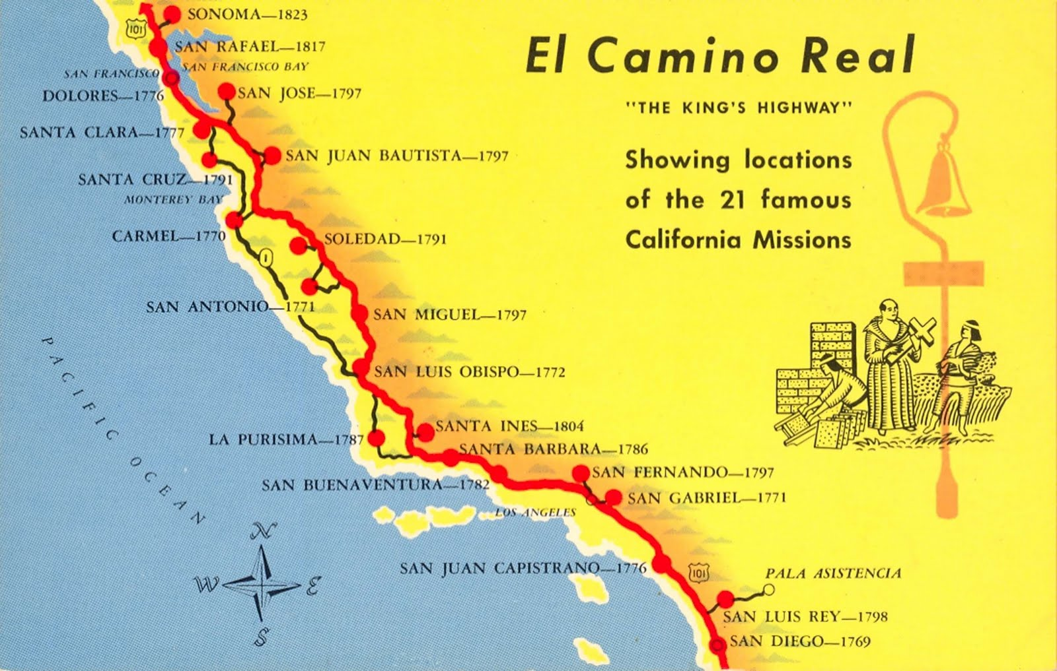
Doctrine of Discovery and Violence to Place and People in California

Slide 28
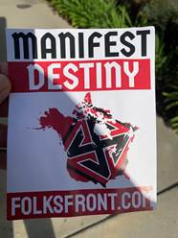
From the Global to the Local: International Roots of Settler Colonialism--Doctrine of Discovery & Manifest Destiny
Doctrine of Discovery
In the bull of 1452, Pope Nicholas directed King Alfonso to "capture, vanquish, and subdue the saracens, pagans, and other enemies of Christ," to "put them into perpetual slavery," and "to take all their possessions and property."
Manifest Destiny
The belief that the United States has some unique moral virtues that other countries do not possess; the idea that the United States has a mission to redeem the world by spreading democracy, and a divinely ordained destiny to accomplish these tasks.

Slide 29
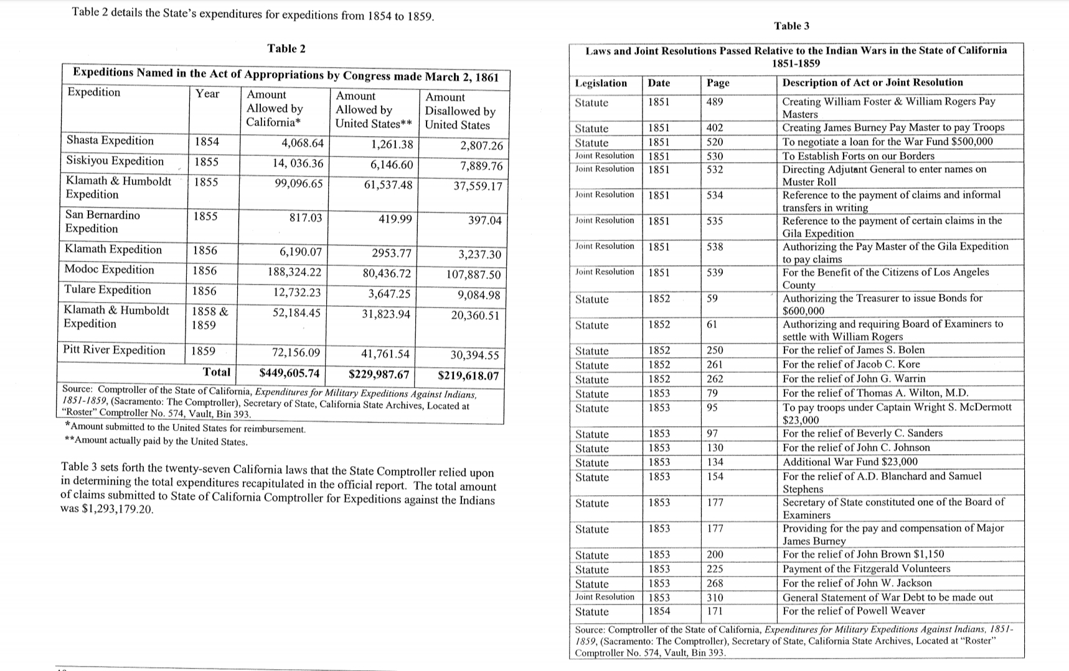
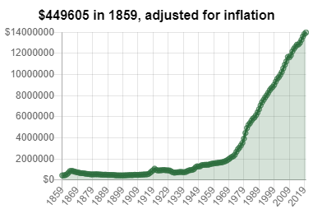
California Financed Attempted Genocide

Slide 30
Early California Anti-Indian Law, Policy and History
1850: AN ACT FOR THE GOVERNMENT AND PROTECTION OF INDIANS
1858 - AN ACT TO PROVIDE FOR BINDING MINORS AS APPRENTICES, CLERKS AND SERVANTS
1855 – AN ACT TO PUNISH VAGRANTS, VAGABONDS, AND DANGEROUS AND SUSPICIOUS PERSON
1850 - 1859: CALIFORNIA MILITIA AND “EXPEDITIONS AGAINST THE INDIANS”
California Land Claims Act of 1851
18 Unratified Treaties

Slide 31
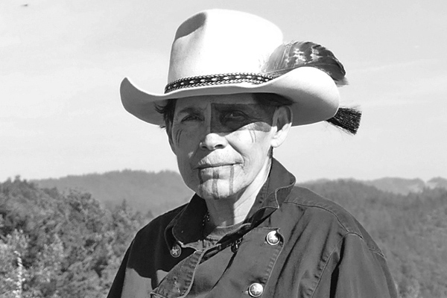
Indigenous Perspectives on Settler State Climate Violence in California
“It is difficult to be Indian under any circumstances; think what it must be like to see a phenomenon like Los Angeles spreading over your meadows and valleys, diverting your rivers, building parking structures on your holy sites, transforming the land that nurtured your ancestors into something unrecognizable.”
--L Frank Manriquez, Tongva & Ajachemem Artist, Writer, Activist
L. Frank Manriquez and Kim Hogeland, First Families-A photographic History of California Indians (Berkeley: Heyday Books, 2007), 93, as quoted in AnMarie Mendoza, The Aqueduct Between Us: Inserting and Asserting an Indigenous California Indian Perspective about Los Angeles Water (2019).

Slide 32
Self Determination, Sovereignty and Government-to-Government Consultation
Indigenous Self Determination–Article 3 UNDRIP Indigenous peoples have the right to self-determination. By virtue of that right they freely determine their political status and freely pursue their economic, social and cultural development.
Tribal Sovereignty– “refers to the legal recognition in the United States of America law of the inherent sovereignty of American Indian Nations. The law applied to American Indians by the US government is called Federal Indian Law. Although undermined by various Acts, legal decisions, and policies, it still stands to this day. Indian reservations are recognized as what can be termed “nations within.” Each has its own government and sovereign powers to make laws, tax, etc. and most also have their own tribal justice system, also based upon their inherent powers.” Indigenous Environmental Network
Indigenous Sovereignty
Notes:
Angela

Slide 33
Self Determination, Sovereignty and Government-to-Government Consultation
Indigenous Sovereignty– “is distinguishable from Tribal Sovereignty in that it is not a nation-state recognition of inherent sovereignty under nation-state dominion. Rather, it arises from Indigenous Traditional Knowledge, belonging to each Indigenous nation, tribe, first nation, community, etc. It consists of spiritual ways, culture, language, social and legal systems, political structures, and inherent relationships with lands, waters and all upon them. Indigenous sovereignty exists regardless of what the nation-state does or does not do. It continues as long as the People that are a part of it continue.” Indigenous Environmental Network
Notes:
Angela

Slide 34
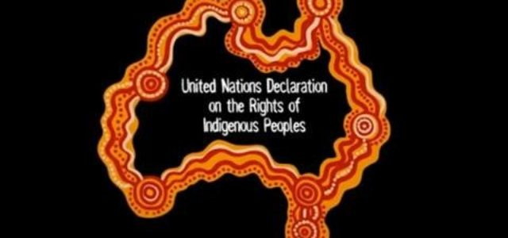
United Nations Declaration on the Rights of Indigenous Peoples
Notes:
California adoption of UNDRIP by joint resolution

Slide 35
UNDRIP
Article 10
Indigenous peoples shall not be forcibly removed from their lands or territories. No relocation shall take place without the free, prior and informed consent of the indigenous peoples concerned and after agreement on just and fair compensation and, where possible, with the option of return.
Article 11, Section 2
States shall provide redress through effective mechanisms, which may include restitution, developed in conjunction with indigenous peoples, with respect to their cultural, intellectual, religious and spiritual property taken without their free, prior and informed consent or in violation of their laws, traditions and customs.
Notes:
Angela

Slide 36
UNDRIP
Article 25
Indigenous peoples have the right to maintain and strengthen their distinctive spiritual relationship with their traditionally owned or otherwise occupied and used lands, territories, waters and coastal seas and other resources and to uphold their responsibilities to future generations in this regard.
Notes:
Angela

Slide 37
Federal Laws
National Historic Preservation Act
American Indian Religious Freedom Act
National Environmental Policy Act
Native American Graves Protection and Repatriation Act
Notes:
Angela

Slide 38
State Laws-Native American Heritage Commission
California Native American Heritage Commission
Sacred Lands Inventory
Section 5097.9 Public Resources Code
No public agency, and no private party using or occupying public property, or operating on public property, under a public license, permit, grant, lease, or contract made on or after July 1, 1977, shall in any manner whatsoever interfere with the free expression or exercise of Native American religion as provided in the United States Constitution and the California Constitution; nor shall any such agency or party cause severe or irreparable damage to any Native American sanctified cemetery, place of worship, religious or ceremonial site, or sacred shrine located on public property, except on a clear and convincing showing that the public interest and necessity so require. The provisions of this chapter shall be enforced by the commission, pursuant to Sections 5097.94 and 5097.97
Notes:
Angela

Slide 39
State Laws–EO B-10-11 and EO-N-15-19
California Law EO B-10-11 & EO N-15-19
Executive Order B-10-11--IT IS FURTHER ORDERED that it is the policy of this Administration that every state agency and department subject to my executive control shall encourage communication and consultation with California Indian Tribes. Agencies and departments shall permit elected officials and other representatives of tribal governments to provide meaningful input into the development of legislation, regulations, rules, and policies on matters that may affect tribal communities. For purposes of this Order, the terms “Tribe,” “California Indian Tribe”, and “tribal” include all Federally Recognized Tribes and other California Native Americans.
Executive Order N-15-19-- “apologizes on behalf of the citizens of the State of California to all California Native Americans for the many instances of violence, maltreatment, and neglect California inflicted on tribes…”
Notes:
Angela

Slide 40
State Laws Government to Government Consultation
SB 18–Traditional Tribal Cultural Places (Adopted in 2004) In recognition of California Native American tribal sovereignty and the unique relationship between California local governments and California tribal governments, it is the intent of the Legislature, in enacting this act, to accomplish all of the following:
(1) Recognize that California Native American prehistoric, archaeological, cultural, spiritual, and ceremonial places are essential elements in tribal cultural traditions, heritages, and identities…..
(3) Establish government-to-government consultations regarding potential means to preserve those places, determine the level of necessary confidentiality of their specific location, and develop proper treatment and management plans.
Notes:
Angela

Slide 41
State Laws Government to Government Consultation
AB 52 (Adopted in 2014) Assembly Bill 52 (AB 52) “recognizes California tribes’ expertise regarding cultural resources and provides a method for agencies to incorporate tribal knowledge into their CEQA environmental review and decision-making processes. Under AB 52, California tribes now have the ability to establish, through a formal notice letter, a standing request to consult with a lead agency regarding any proposed project subject to CEQA in the geographic area with which the tribe is traditionally and culturally affiliated.”
–Tribal Consultation Under AB 52: An Overview and Tips for Compliance
Notes:
Angela

Slide 42
State Laws Government to Government Consultation
DWR Policy
California Native American tribal governments and tribal communities have sovereign authority over their members and territory and a unique relationship with California’s resources. California tribes and tribal communities, whether federally recognized or not, have distinct cultural, spiritual, environmental, economic, and public health interests and valuable traditional cultural knowledge about California resources.
Notes:
Angela

Slide 43
State Laws Government to Government Consultation
The California Water Boards Tribal Consultation Policy (policy) is to develop effective communication with all California Native American Tribes that allows for meaningful participation and input while developing or revising the Water Boards’ regulations, rules, policies, programs or plans that may impact Tribes. It is the intent of this policy to establish the guiding principles to consult with California Native American Tribes on a government-to-government basis when requested and deemed to be appropriate through discussion with the requesting tribe(s), or as required by statute (e.g. Assembly Bill 52 and Section 106 National Historic Preservation Act).
Notes:
Angela

Slide 44
State Laws–Tribal Cultural Use as Beneficial Use
Tribal Beneficial Uses – Cultural Uses of Water
Since time immemorial, California Native American Tribes have used, and in some cases continue to use, water to support their cultural, spiritual, ceremonial, and/or traditional rights. Tribal Beneficial Uses provide a water quality safety measure that considers these specific uses of water by individuals, households, or communities of California Tribes.
Regional/Divisional Tribal Coordinators Adriana Renteria, Tribal Liaison Email: Tribal-Liaison@waterboards.ca.gov Phone: (916) 216-1126
Notes:
Angela

Slide 45
5 Minute Break
Please take this time to stretch and grab a drink and/or snack

Slide 46
State Laws–UN Declaration on the Rights of Indigenous Peoples adopted by Joint Resolution in California
Joint Resolution 42 – UNDRIP (Adopted in 2014)
Resolved by the Assembly and the Senate of the State of California, jointly, That the Legislature of California expresses its endorsement of the principles of the United Nations Declaration on the Rights of Indigenous Peoples adopted by the United Nations General Assembly, and recognizes the call for increased awareness, sensitivity, and respect for issues of sovereignty, sacred and historic sites and traditions, and other vital aspects of the heritage of Native Americans and indigenous peoples implicit in those principles, notwithstanding the nonbinding nature of the declaration;
Notes:
Angela

Slide 47
History of the Legal rights of Nature
1972-Publication of law professor Christopher Stone’s seminal article, “Should trees have standing - toward legal rights for natural objects.”
He argued that under existing law, nature was considered right-less, with no legally recognized right to defend and enforce
2006-Tamaqua Borough, Pennsylvania bans dumping of toxic sewage sludge as the violation of the Rights of Nature. The first place in the world to recognize the rights of Nature in Law
2005- Navajo nation tribal council drew upon the nations previous codification of non-colonial traditional and customary law when it banned uranium mining
SOURCE Community Environmental Legal Defense Fund https://celdf.org/rights-of-nature/timeline/

Slide 48
Indigenous led efforts
2008 - Ecuador becomes the first country in the world to recognize the Rights of Nature in its national constitution.
Therefore in 2011 the first Rights of Nature court decision was issued in the Vilcabamba River case in Ecuador, upholding the Rights of Nature constitutional provisions
Source: Global Alliance for the Rights of Nature
https://www.garn.org/

Slide 49
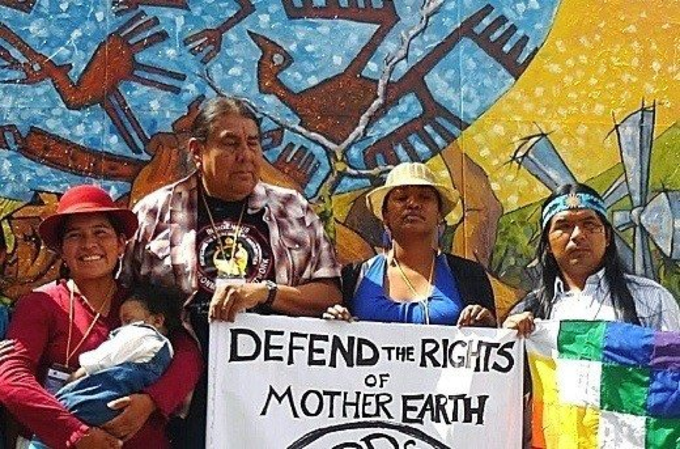
Indigenous Rights of Nature efforts
BOLIVIA
“When the passage of Bolivias Law of the Rights of Mother Earth was announced to the world in late 2010, international media described the new legislation in glowing terms --- transformative, astonishing,
unprecedented, a turning point.”
- Lee Bran, Nature Needs Half, 2018

Slide 50
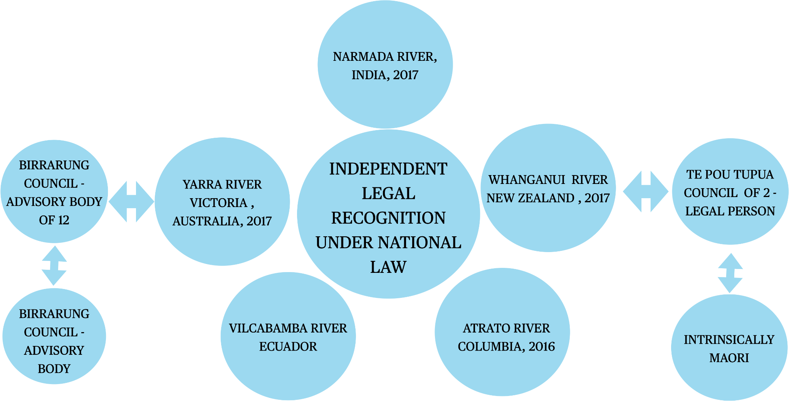
Personhood to bodies of water

Slide 51
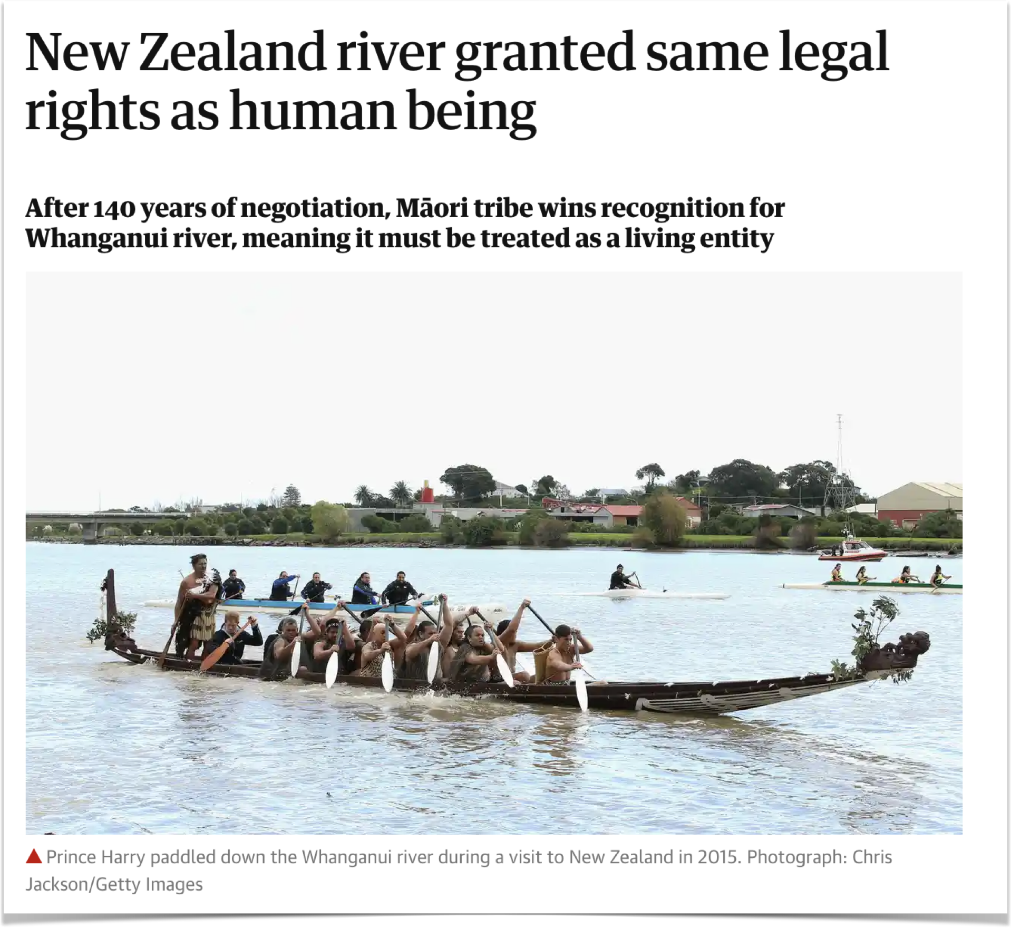
New zealand
“.... treating the river as a living entity is the correct way to approach it, as an indivisible whole, instead of the traditional model for the last 100 years of treating it from a perspective of ownership and management.”
SOURCE:
https://www.theguardian.com/world/2017/mar/16/new-zealand-river-granted-same-legal-rights-as-human-being
Notes:
2017 the New Zealand Parliament passes the Te Awa Tupua Act granting the Whanganui River legal status as an ecosystem.
Prior to that in 2014 they had designated over 2k acres of a park legal rights.

Slide 52
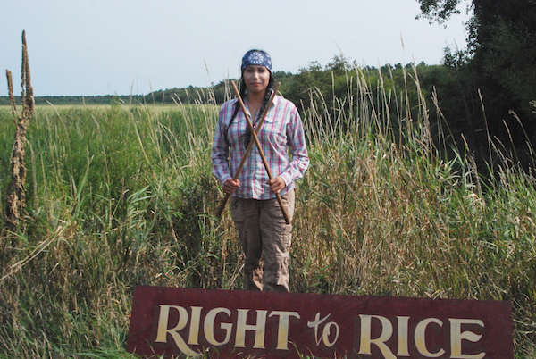
Northern Tribes
2017- the Ponca Nation in Oklahoma passed a statute recognizing the rights of nature in response to their own struggle with fracking.
2021- the White Earth Band of Ojibwe adopted a Rights of Manoomin law to protect the legal rights of manoomin, or wild rice, and the fresh water resources and habitats on which it depends.
Source; Community Environmental Legal Defense Fund
Notes:
In the Intercontinentalcry.org you will find a list of tribal efforts to grant rights to nature.

Slide 53
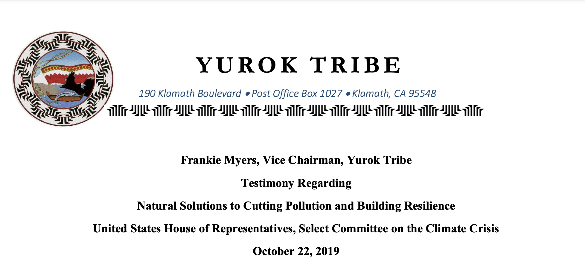
California tribes
III. Declaring Personhood Rights to Nature for Climate Resiliency
…On May 9, 2019, the Yurok Tribal Council adopted Resolution 19-40 granting the rights of Personhood to the Klamath River and established the Rights of the Klamath River to exist, flourish, and naturally evolve; to have a clean and healthy environment free from pollutants; to have a stable climate free from human-caused climate change impacts; and to be free from contamination by genetically engineered organisms. The Klamath is the first river in Northern America to have personhood rights declared…

Slide 54
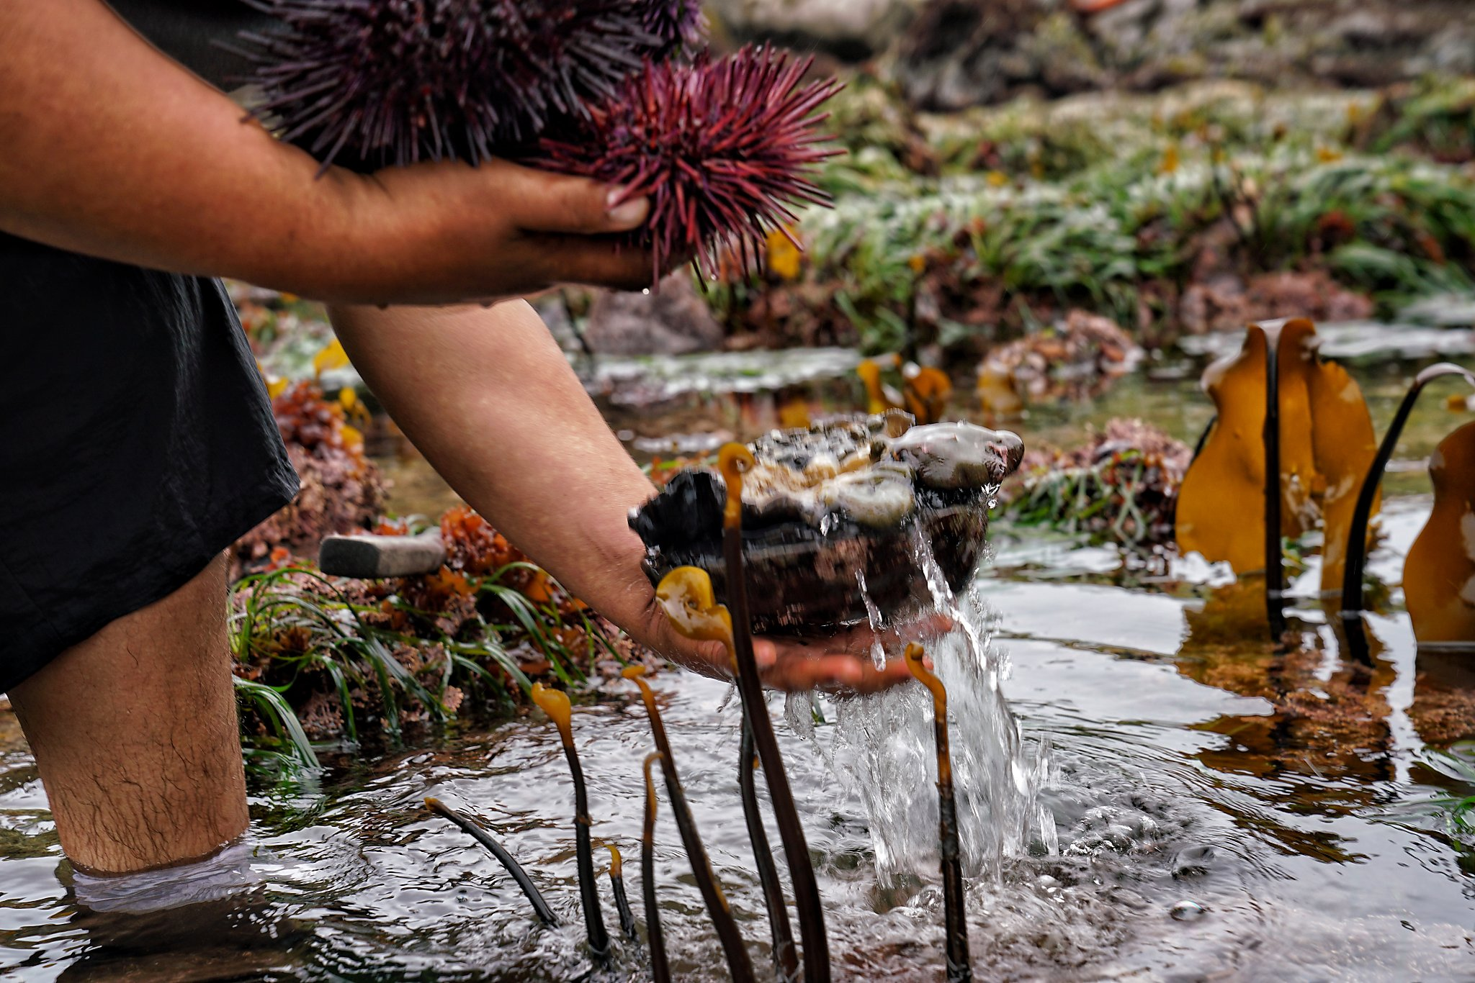
Yurok Tribe - Northern California
…The law encourages the Yurok people to continue living and practicing their traditional lifeways to harvest plants, salmon and other fish, animals, and other life-giving foods and medicines for both subsistence and commercial uses. The law also establishes the rights of the Yurok people to protect and represent the River in Yurok courts if they witness harms impacting the River. Through this legal mechanism, the Yurok Tribal Council wished to encourage the courts to hear and adopt traditional ecological knowledge to ensure the reciprocal relationship to care and protect each other between the Yurok people and the Klamath River can be fully adopted in judicial proceedings.

Slide 55
considerations
What are some of the various approaches to attaining legal hood or independent voice for a river ?
Protection principles utilized to inform statutory decision makers - 2017 Yarra River Protection Act of Victoria, Australia
“Principals reflect indigenous cultural values, heritage and knowledge and the importance of involving traditional owners in policy planning and decision making “
Post-settlement cultural diversity and heritage values embodied in environmental, social, recreational, management and general protection principals
Can be distinct according to locale and entail both legal and independent voice

Slide 56
Implications / impacts
•Legal economic costs when dealing with government jurisdictions. This can be more challenging for non federally recognized tribes due to limited resources and capacity.
•Working within colonial structures can impose restrictions and threaten tribal sovereignty
•Long term , midterm and short term impacts
•Compromises indigenous peoples inherent rights and obligations as first peoples to steward their original traditional territories and it’s resources

Slide 57
Language and Actions matter
Relationship: pro-active efforts to involve ALL local tribes that share water or land is necessary for true full engagement and honest connections.
Respect: demonstrate regard or consideration for ALL life (flora, fauna and beyond)
Restoration: the action of returning something to a former owner, place, or condition.
Rematriation :retuning of the feminine seeds back into the communities of origin. The Indigenous concept refers to reclaiming of ancestral remains, spirituality, culture, science, knowledge and resources, instead of the more Patriarchally associated Repatriation.

Slide 58
Questions?

Slide 59
Understanding How to be a Good Ally

Slide 60
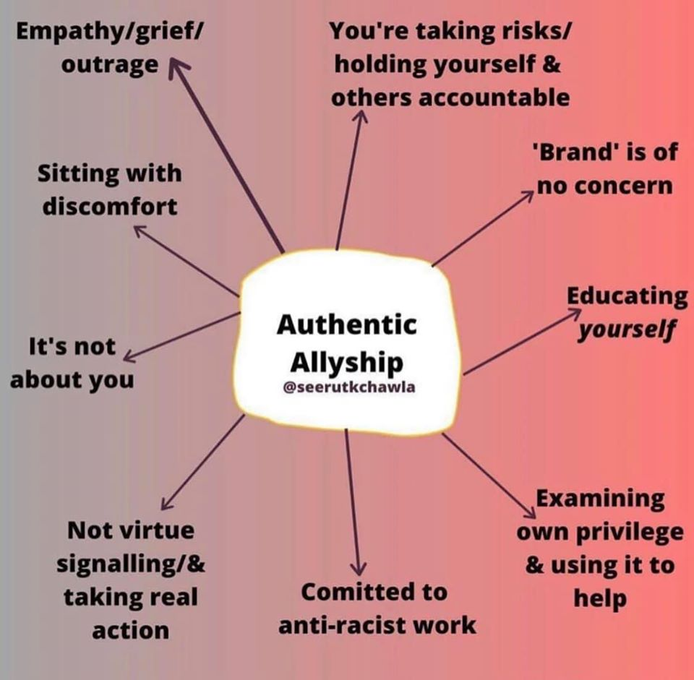
Allyship
Opening space with Land Acknowledgments in a non performative and understanding that Land Acknowledgements are the tip of the iceberg
Creating meaningful relationships with Indigenous people whose homelands you live and work on
Working with Tribal families and communities to understand their view points and needs

Slide 61
Allyship
Being willing to give up your seat at the table if the Indigenous voices are not present
Giving credit where credit is due: if an idea is utilized from Native folks they should be involved in how the idea is presented and compensated
Compensating Indigenous folks for their time, knowledge and work
Aside from listening, actually following through with the help you are offering…Don’t be a symbolic ally, no one wants that
Roland Pacheco
Indigenous Visions on Sacred Waters

Slide 62
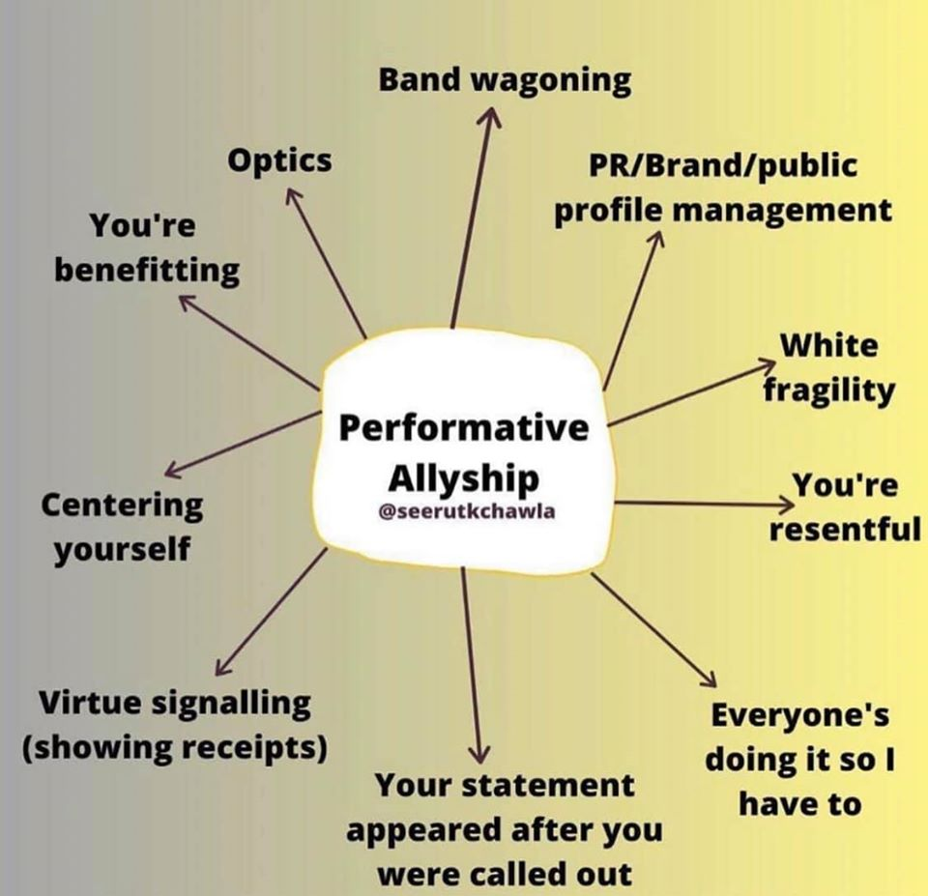
Appropriation
Wearing clothing to show appreciation/respect
Stealing ideas and quotes from Indigenous folks
Excluding Indigenous folks on conversations and actions about their homelands
Using ceremonial items including Sage out of context
Having Native folks involved at the slightest capacity to mark the box for public approval

Slide 63
Best Practices & Lessons Learned on Allyship
Positives examples of leadership
Negative Examples of leadership
Why are these impactful?

Slide 64
Questions?

Slide 65
Resources
The Aqueduct Between Us
Indigenous Visions on Sacred Waters
Supplemental Readings
Note, there is no expectation that you review these resources prior to the workshop. These resources are curated to supplement the workshop topics and serve as ongoing resources for your work
● Charles Sepulveda, Our Sacred Waters: Theorizing Kuuyam as a Decolonial Possibility
● Shannon Biggs, Tom Goldtooth, Osprey Orielle Lake, Rights of Nature & Mother Earth: Rights-based law for Systemic Change.
● Cara Romero (Chemehuevi) and Alexis Bunten (Aleut/Yup’ik), Bioneers Indigeneity Program, What do the Rights of Nature have to do with Indigeneity?
● The Yurok Nation Just Established the Rights of the Klamath River
● Larisa K. Miller, The Secret Treaties with California Indians
● Cultural Appreciation or Appropriation?
● Native Voices Rising: A Case for Funding Native Led Change
● California Tribal Water Stories, from the 2009 California Tribal Water Summit
Notes:
Angela add in state fed law and UNDRIP

Slide 66
Resources
Presentation References
What is tribal sovereignty and what does it mean for Native Americans
NCAI, Indian Country 101
High Country News, How the Yurok Tribe is Reclaiming the Klamath River, Ana V. Smith, June 11, 2018
Gabriel Eckstein, Ariella D’Andrea, Virginia Marshall, Erin O’Donnell, Julia Talbot-Jones, Deborah Curran & Katie O’Bryan, Conferring legal personality on the world’s rivers: /a Brief intellectual assessment, 44 Water Int’l (2019)
NEED DATABASE ACCESS FOR THIS ARTICLE
High Country News, The Klamath River now has the legal rights of a person, Ana V. Smith, September 24th, 2019
https://www.theguardian.com/world/2017/mar/16/new-zealand-river-granted-same-legal-rights-as-human-being
https://intercontinentalcry.org/indigenous-protected-areas-are-the-next-generation-of-conservation/
https://www.npr.org/2019/08/03/740604142/should-rivers-have-same-legal-rights-as-humans-a-growing-number-of-voices-say-ye

Slide 67
Contact US:
Sacred Places Institute for Indigenous Peoples
Angela Mooney D’Arcy (she/her)
Email: angela@sacredplacesinstitute.org
Gabriella Lassos (she/her)
Email: gabriella@sacredplacesinstitute.org
Jessa Calderon (she/her)
Email: jessa@sacredplacesinstitute.org
Maritza Alvarez (she/her)
Email: maritza@sacredplacesinstitute.org
TreePeople:
Roland Pacheco (he/him)
Email: rpacheco@treepeople.org
www.sacredplacesinstitute.org
www.treepeople.org

